Slide 1

BMW
Smart technical approach to solve business problem by redefining strategy
Team 2
Harshit Joshi
Irfan Olia
Siddharth Gulati
Parth Maheshwari

Slide 2
What Employees Feel
Our plant is about more than just automobiles. We’re always looking for new solutions to make better cars and more efficient processes. I’m proud to work with BMW Associates who never settle for second best.
Beth Philips
Energy Center, BMW Manufacturing Plant, Spartanburg, USA

Slide 3
What People Say
From Nike, we buy victory. From Under Armour, we buy protection. From Lululemon, we buy zen. From Patagonia, we buy conservation. From BMW, we buy performance.
Andy Dunn
CEO, Bonobos Inc.

Slide 4
Executive Summary

Slide 5
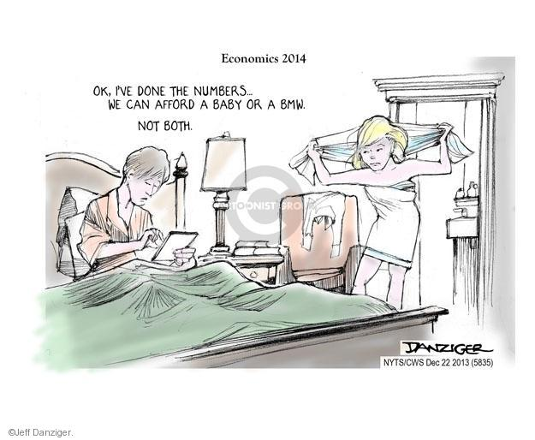
Problem Statement
“BMW wants to capture a major market share of the premium automobile industry without compromising its performance, sophistication and quality. The constraint of having an automobile as the core product limits the scope for digitization and to compete for internal operations, products and services need to exploit IT without giving an opportunity for cost leadership to its competitors.”

Slide 6
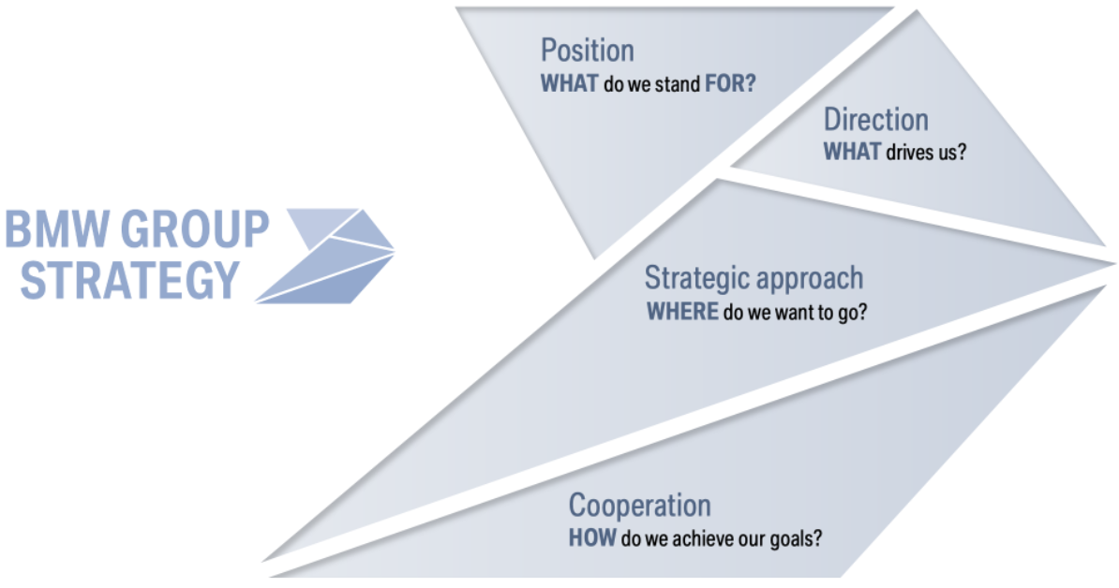
Strategic Solution
IT is a tool which can fit into any part of the organization. What BMW needs to decide is what tools could provide maximum efficiency in the operations and can bring radical innovation in the product.
Implementing AI
Finding combination of best possible add-ins in a vehicle
Providing performance simulations and customer scores
Supporting manufacturing and reducing contact points
Collaboration
Building alliance with rising innovative companies
Outsourcing technology and components where required
Enhancing Customer Experience
Smart showrooms
Reducing customer touch points
Targeting market niche and analyzing purchase and behavior patterns for existing customers

Slide 7
Introduction
BMW ( Bayerische Motoren Werke AG), is a German automaker noted for quality sports sedans and motorcycles.
The official founding date of the German motor vehicle manufacturer BMW, headquartered in Munich, was March, 1916,
Company manufactured aircraft engines from 1917 until 1918 and again from 1933 to 1945.
Began producing motorcycles in the 1920s.
BMW entered the automobile business in 1928

Slide 8
Introduction Summary
BMW Headquarters in Munich, Germany
Industry served | Automotive, motorcycles and financial services
Predecessors | Rapp Motorenwerke Bayerische Flugzeugwerke Fahrzeugfabrik Eisenach
Founded | 7 March 1916
Founders | Karl Rapp, Gustav Otto, Camillo Castiglioni, Franz Josef Popp
Geographic Areas served | Over 150 Countries Worldwide
Current CEO | Harald Krüger

Slide 9
BMW Background & Timelines (1916 – 1961)
Timeline | Event
1916 | On March 7, 1916, the Flugmaschinenfabrik Gustav Otto company had merged into Bayerische Flugzeug-Werke AG (BFW) at government behest.
1917 | The Rapp Motorenwerke company became Bayerische Motoren Werke Gmbh which was converted into AG (public limited company)
1922 | In 1917, BMW AG subsequently transferred its engine construction operations – including the company and brand names – to BFW in 1922. Therefore, this date is considered as a founding date of BMW
1923 | The first BMW Motorrad, announced its first motorcycle R32. Unitl then company only produced engines rather the complete vehicles.
1928 | BMW became automobile manufacturer by purchasing a company called Fahrzeugfabrik Eisenach
1929 | First small car was manufactured under the license of Austin Motor Company
Timeline | Event
1933 | Underwent a transformation from a mobility company to an ornament company to support German War economy
1934 | BMW AG outsourced its aeroengine division The Letters BMW were included in the name
1939 | BMW takes over Brandenburgischen Motorenweke
1945 | Reconstrution difficulties due to WWII. Munich Plant is dismantled
1949 | BMW R24 motorcycle was developed. 9144 were sold in 1949
1951 | BMW 501 – the first post war car was manufactured
1961 | 1500 Model - new class makes a breakthrough

Slide 10

First Post WWII Vehicle Built in 1951

Slide 11

1500 Model -The "New Class" makes a breakthrough – 1961

Slide 12
BMW Timelines (1961 - Present)
Timeline | Event
1967 | Munich plant reached the capacity limit, New Plant Dingolphin was built on a new location
1971 | BMW Kedit GMBH was formed to provide financing to dealership and to fund its own transactions,
1972 | BMW starts in South Africa with Roslin plant in Pretoria South Africa BMW motor sport GMBH company was formed
1973 | BMW headquarters and BMW museum was established in Munich – Four Cylinder Building World Wide creation of Sales Subsidiaries
1985 | BMW Technik GMBH was formed as a thinktank
1994 | BMW is launched in USA
Timeline | Event
1998 | BMW acquires Rolls Royce motor cars
1999 | BMW launcches first SUV X5
2001 | Mini was launched by BMW
2004 | Launched a Joint venture in China
2007 | BMW adopted strategy # 1 with its 4 pillars I- Growth, shopping the future, profitability, access to technology & customers
2013 | BMW launched first electric vehicle i3
2022 | BMW launched i7 – an electric version of the brand's next-generation 7 Series as one of BMW's flagship models with range of new technologies into the mix.

Slide 13
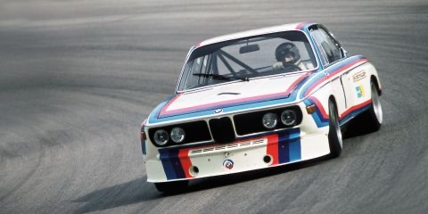
1972 - BMW Motorsport GMBH was formed

Slide 14
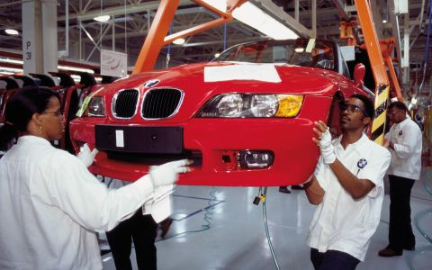
1994 - BMW is launched in USA

Slide 15
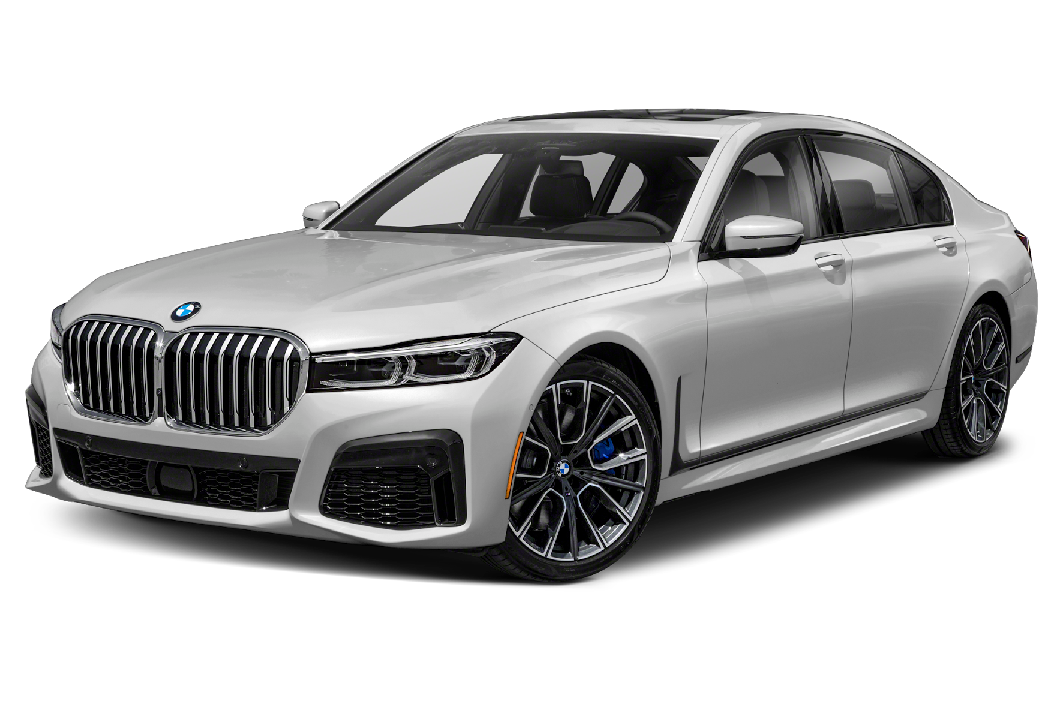
BMW 7 Series 2022 Electric Version with modern Technology

Slide 16
Purpose
World's leading provider of premium automobile products and services
Sustainable premium manufacturer for individual mobility.
Compliance with social and ethical standards
Leader of resource efficiency in production to the entire life cycle Reducing CO₂ emissions and focus on Electromobility
Manufacture using fully reusable and recoverable components

Slide 17
Size, Revenue, Profits
Current Employees Strength | 118,909 worldwide
2021 Revenue | 111.24 billion euros or $122.4 billion.
2021 Profits | 12.5 billion euros or $13.8 billion
Profit Margin | 11.13%
Current Market CAP | 50.01B EUR
Current Stock Price | $85.28

Slide 18
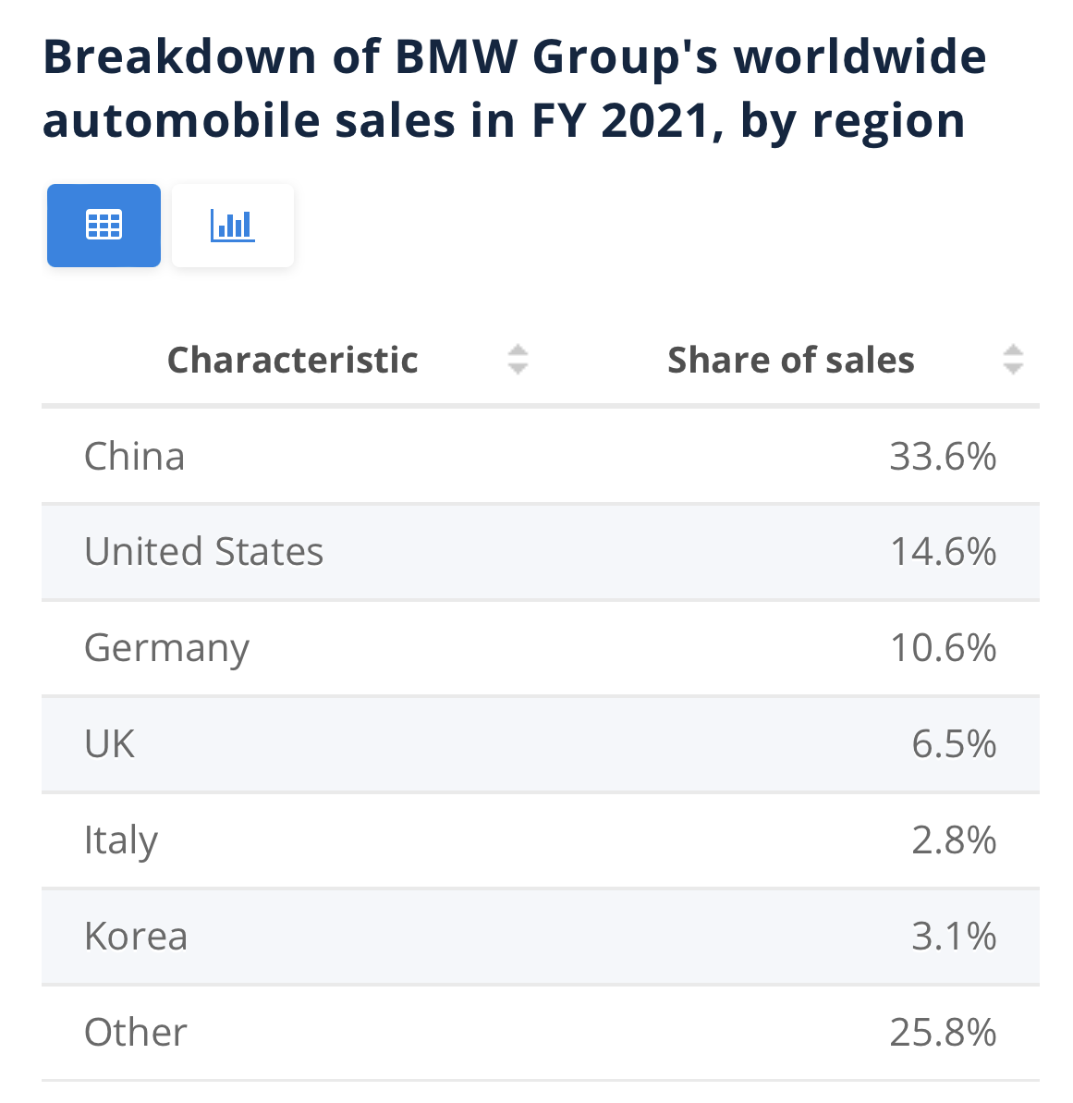
Breakdown of BMW Sales worldwide
*Extracted from statista.com

Slide 19
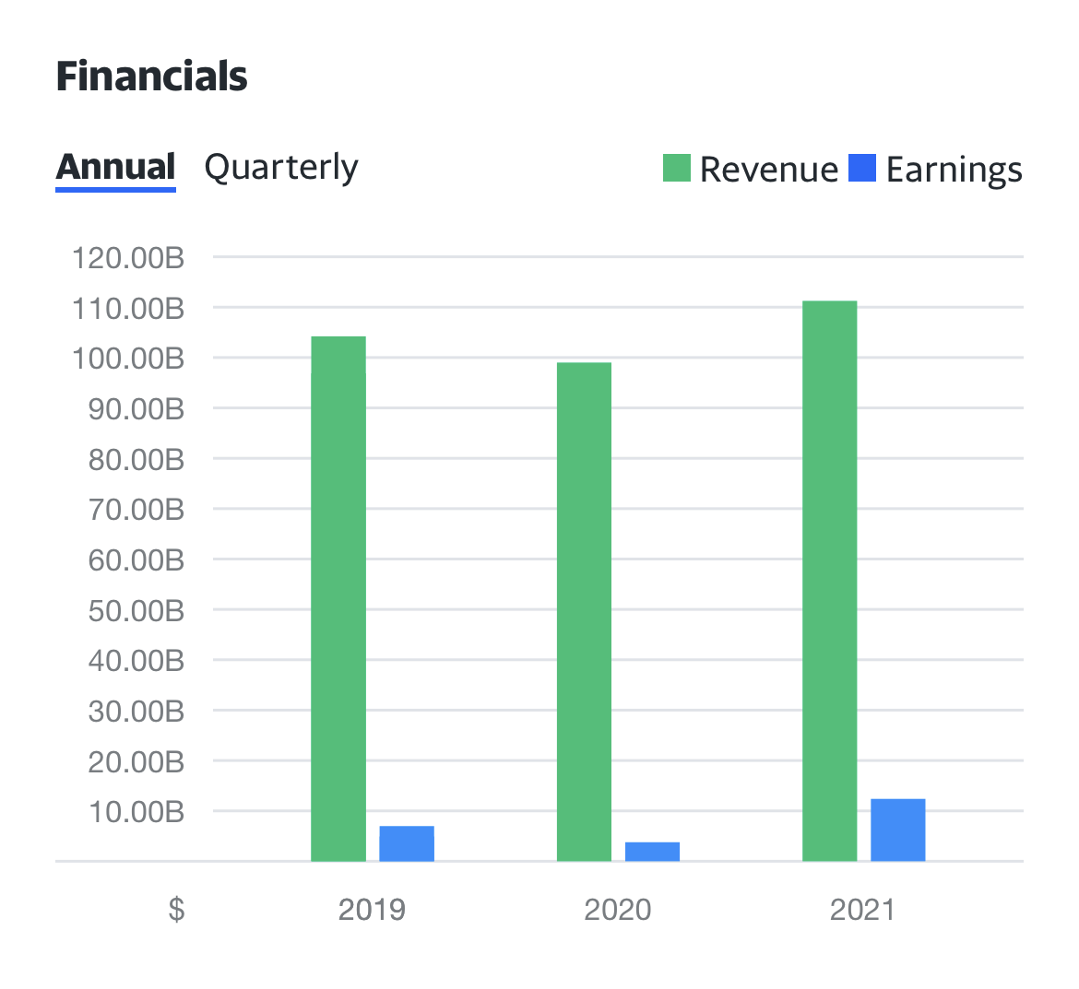
BMW Revenue Growth (2019 – 2021)
*Extracted from yahoo finance

Slide 20
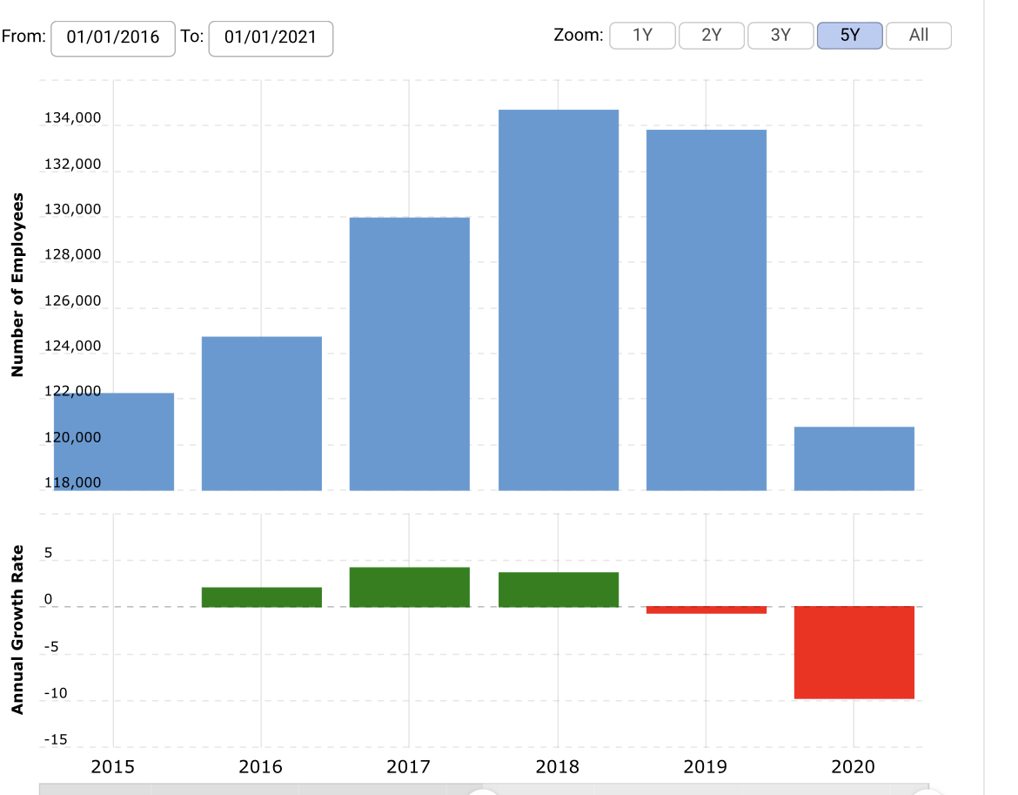
BMW Employee Growth Rate
*Extracted from macrotrends.net

Slide 21
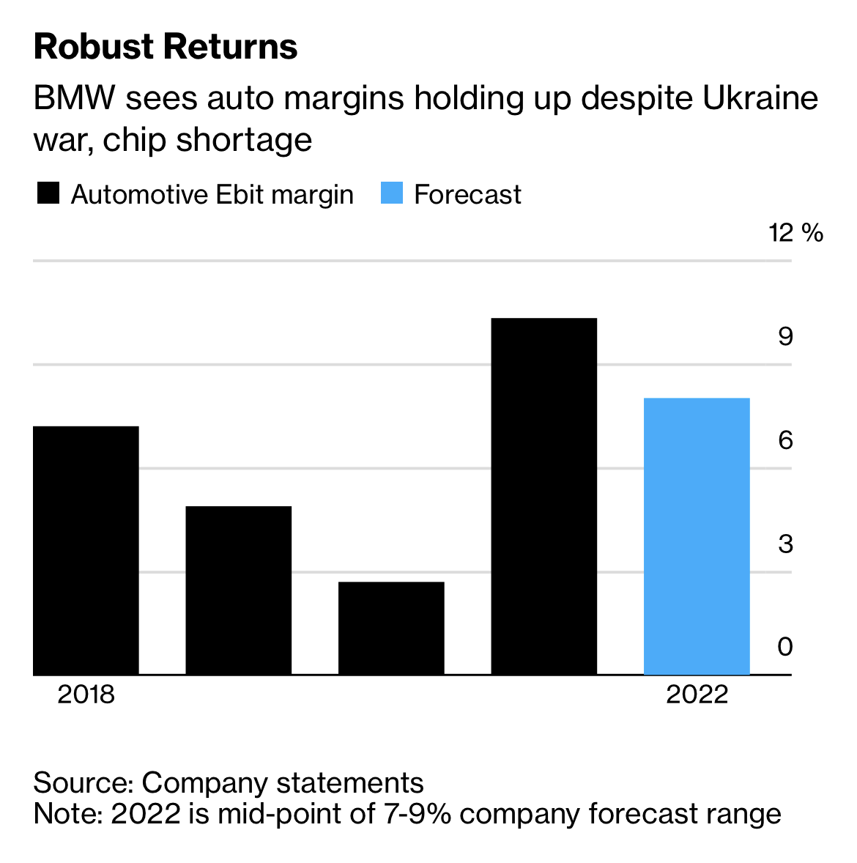
BMW Outlook 2022
*Extracted from bloomberg.com

Slide 22
BMW Group Retail Customer Segments
 | BMW | MINI | Rolls-Royce
Region | Domestic/international | Domestic/international | Domestic/international
Density | Urban/rural | Urban | Urban
Age | 20-65 | 20-45 | 40+
Gender | Males & Females | Males & Females | Males & Females
Social Class | Middle class / Upper class | Middle class | Upper Class
Income | High | High | High
Occupation | Professionals & executives | Professionals & executives | Professionals & executives
Degree of Loyalty | ‘Hard core loyals, Soft core loyals, Switchers’ | Soft core loyals, Switchers | Hard core loyals
Lifestyle | Aspirer Succeeder | Explorer Reformer | Resigned
Extracted from research-methodology.net

Slide 23





Major Competitors
 | Mercedes-Benz USA | AUDI | Fiat Chrysler (FCA) | Porsche | Lexus
Founding Date | 1965 | 1909 | 2014 | 1931 | 1989
Locations | Atlanta GA, USA | Ingolstadt, Germany | Auburn Hills, MI, USA | Stuttgart, Germany | Nagoya, Aichi, Japan
Employees | 1400 | 90,783 | 198,545 | 36,359 | 40,023
Revenue | 109.7B Euros | $67.4B | $172.4B | 19.28B Euros | $19.3B
Market CAP | $73.284B | $ 82.91B | $ 30.91B | $29.95B | $170.78B

Slide 24
Corporate Strategy

Slide 25
Mission
The BMW brand is known for sheer driving pleasure by giving premium products and services for individual mobility.

Slide 26
Vision
The BMW brand is known for modern car with sheer driving experience and The Ultimate Driving Machine by maintaining core values as technology, innovation, performance, quality, reliability, exclusivity and customer satisfaction. BMW goal is to be the most successful premium manufacturer in the industry.

Slide 27
Objectives
Digital Transformation
AI used to optimize energy management both in buildings and in vehicles.
Expansion of electromobility
Accomplish Business Goals
Sustainable premium manufacturer
Build automobile product with modern technology

Slide 28
Value Statement
Customer Satisfaction
Innovation
Developing vehicles with up-to-date modern features and building product with future tech and sustainability.
At BMW we provide best experience of driving vehicle with latest tech support for comfortable and safe ride.
Notes:
https://www.stackoverflowbusiness.com/talent/about
https://www.stackoverflowbusiness.com/talent/platform/source/candidate-search

Slide 29
Corporate Strategy
We focus on our global customers and meet their needs by combine pioneering technologies, emotional products and personalized customer support to create a unique overall experience.
Position
We offer thrilling products - today and for future generations. High profitability secures our independence as a company.
Cooperation
Our values are the basis for cooperation. We work hand in hand internally and with our external partners. To bring success to the company.
We stand for first class individual mobility and contribute to the sustainable development of our planet. We reconcile economy, ecology and society.
Direction
Strategic Approach
Notes:
https://www.stackoverflowbusiness.com/talent/about
https://stackoverflow.com/teams
https://www.stackoverflowbusiness.com/talent/platform/source/candidate-search

Slide 30
Business/Service Unit Strategy

Slide 31
Mission
To be the leading supplier of premium products and premium services for individual mobility

Slide 32
Vision
BMW collaborates with the world's greatest engineers with a vision to become a successful global company that must be able to thoroughly understand and fulfill customers’ needs and wishes by creating an emotional bond between the driver and BMW

Slide 33
Objectives
Target people who are finding success in their career, have a taste of idealistic products & values their own social status
Work towards automation and electromobility
To be profitable and to enhance long-term value
Maintain core values as technology, innovation, performance, quality, reliability, exclusivity and customer satisfaction

Slide 34
Value Statement
To create a very personal vehicle. There will always be that highly emotional Connection between a BMW and its driver – Create a Personal Companion

Slide 35
Strategy
Talent
Engagement
Build company’s brand
Enterprise
Production today and tomorrow
Hire and work with the best engineers
Give customers a personal companion and a sheer driving experience
Make technological advancements and be a leader
Ecological and social sustainability,

Slide 36
IT Strategy

Slide 37
Mission
To exploit Artificial Intelligence for reaching the goal of digitization but not shifting the focus from the people. AI being used for enhancing employee capabilities and to improve customer experience and building trust to enhance the value generated by IT.

Slide 38
Vision
To effectively utilize AI by following the 7 principles of AI at BMW and increasing value at every step for customers, employees and business processes. Fulfilling customer needs which differ across the world by combining pioneering technologies, emotions and products to create a unique overall experience.

Slide 39
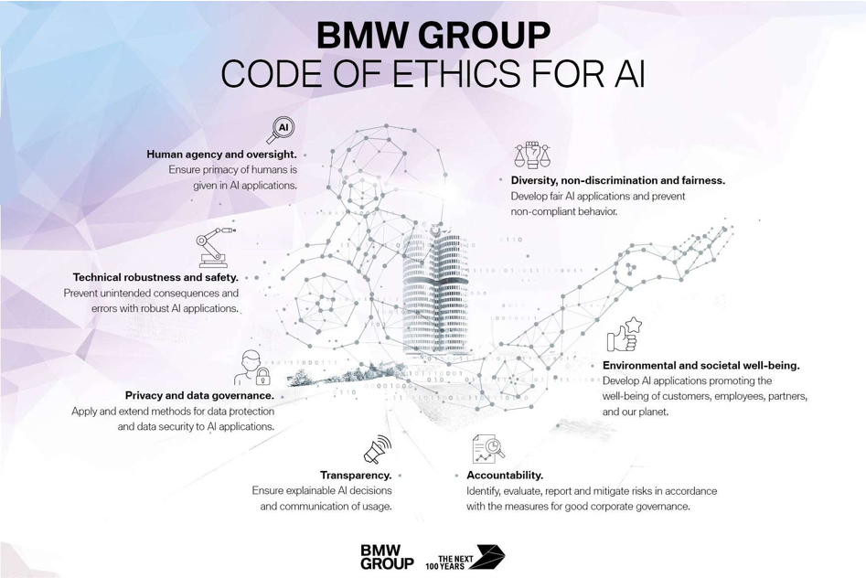

Slide 40
Objectives
Goals and Objectives of BMW with respect to IT
AI being implemented to non-monotonous tasks for enhancing the testing process with the help of deep learning, reducing bottlenecks in assembly line and predictive maintenance
Implementing BMW Operating Systems 7.0 AI successfully which is AI-focused and enabling company-wide networking and knowledge transfer and adding customers to this integrated approach while setting up new market standards
Intelligent data analysis and machine learning being used to optimize energy management both in facilities and in vehicles and further implementing it in enhancing vehicle performance
Providing support of translation tools and context-processing assistants in daily business task while using NPL with intelligent personal assistance and analyzing customer response

Slide 41
Value Statement
Position
Direction
Strategic Approach
Cooperation
Position: Portraying as one of the sustainable companies in the world by maintaining a balance between economy, ecology and society with the help of IT which in turn provides outstanding products and demonstrate responsibility.
Direction: Exploiting AI in business operations for producing thrilling products and using the command over IT for powerful innovations and shaping the future mobility as per the position in the market.
Strategic Approach: Using IT for implementing strategy faster compared to earlier methods and AI being used for choosing the right time of implementing the strategy in the right market scenario. This enables to provide more customized experience to the customers.
Cooperation: Working hand in hand internally and with the external partners for maximizing the value generated and bringing success to the IT oriented manufacturing of the company.

Slide 42
Definition of IT Strategy
IT Strategy
Combining ML and NPL with the engaging AI
Project AI and customer integration
Increasing reach of Image processing AI to departments other than manufacturing
Optimizing energy management in vehicles and facilities
Getting more engaging approach to customer services
Nurturing long term relationship with strategic partners

Slide 43
Mintzberg’s 5 P’s Strategy
Perspective
To revolutionize the way the company operates by integrating AI along with daily operations
To provide more customizable service to customers and gaining a huge competitive advantage
Pattern
Making the processes more digitized for successfully integrating the monotonous ones with Project AI
Plan
Revolutionize the way processes are designed
Position
Ploy
To stay focused and true to the core competency without letting the process change affect the position in the market
Keeping a close track on major competitors and looking at patents being generated with respect to disruptive technology
Identifying customer purchase and behaviours for better service offerings
Providing customer the knowledge of interacting with the service offerings
Aligning the firm’s infrastructure to undergo a radical change
Advancing in the market by maintaining the same brand image and at the same time looking for cost effective way of providing quality services
Looking at ways to deal with the opportunities which could be generated for the competitors while implementing IT strategy

Slide 44
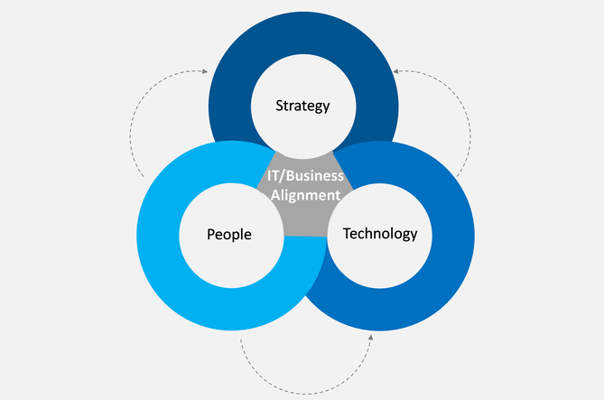
Combined Strategy

Slide 45
Alignment with Corporate and Business/Service Unit
Premium Manufacturer
Value Generation
Premium Services
Individual Mobility and successfulness
Functional Level
SBU Level
Organization Level
Understanding IT by Business
Implementation Alignment
Alignment
Maintaining competitive advantage within an evolving market requirements
IS Plans
Alignment:
Digitization Process + Radical Product Innovation
Product Integration + Customer Knowledge Generation
Planning Alignment
Linking process changes occurring due to IT implementation with business policies and objectives for successful implementation
7 Principles of AI
Organizational Constructs
To proceed with caution in expansion of AI
FIZ Future, AI and Industry 4.0 in development
Sustainability and “360° Electric”
Social Constructs
Agile Project Management
BMW Insider Program
Employees engagement and awareness by using social networking
Dynamics of Alignment

Slide 46
Implementing Alignment
Plan
Identify current issues and problems
Do
Performing departmental wise changes
Check
Collecting data on a regular basis for ensuring that the change processes stay within the control limit
Act
Standardize the solution being generated
Identifying the areas where the implementation should begin first
Considering the implications on connected departments
Assigning roles and responsibilities and ensuring organization is aware about the changing process
Maintaining a regular supply regarding the technological support which is being outsourced
Providing regular training to the employees
Performing iterative testing processes with different scenarios
Ensuring customer satisfaction by performing beta testing
Developing policies for successful implementation of technology within the departments and with customers
Continuous monitoring the process and updating AI

Slide 47
Tools/Process/Methods/Metrics for Ensuring Alignment
Alignment
Portfolio Matrix
Super SWOT
Product Differentiaiton
Scenario Planning

Slide 48
Portfolio Matrix
 |  | Business Strength |  | Business Strength
Market Attractiveness |  | Strong | Medium | Weak
 | High | Protect Position | Invest to Build | Build Selectively
 |  | Huge R&D investment in supporting upcoming Project AI | Adding smart features to the product Focusing on processes after looking at product response | Incremental modifications in processes to bring a radical change
 | Medium | Build Selectively | Selectively/Manage for Earnings | Limited Expansion or Harvest
 |  | Improving customer contact points: Showrooms and Service | Expanding more in hybrid and electronic markets | Adding new AI related features to the product
 | Low | Protect and Refocus | Manage for Earnings | Divest
 |  | Targeting young generation by upcoming products | Customer knowledge being provided about new features helping to retain them | Controversial recalls and negative publicity

Slide 49
Super SWOT
Super SWOT BMW | Strength High quality products Experience in sustainability and green technology Strong brand image One of the largest global supply chains Investment in R&D | Weaknesses Small Portfolio(BMW, Rolls-Royce and MINI) Controversial recalls Has previously faced negative publicity
Opportunities Providing customized products Expanding in autonomous sector Focusing on eco-friendly products Customer priority enabling service innovation Focusing on emerging markets | SO Using the experience to manufacture more environmental focused features in the product Taking advantage of largest supply chain by prioritizing customer service Strong brand image to target growing electric market at right time | WO BMW is having opportunity to expand their portfolio as they did by launching the BMW i and BMW M by launching BMW E Using sustainability and strong brand image to build trust politically Customized products could enable focus on one product at a time and can prevent potential recalls
Threats Rising manufacturing costs Shortage of resources Highly competitive market Major shifts in demographics | ST Using lean manufacturing and agile together to handle rising manufacturing costs Radical innovation to compete in highly competitive market Using brand name to influence customers | WT Controversial recalls increase pressure on supply chain and can further increase manufacturing costs Defective or low quality product can lead to a huge impact in competitive market Small portfolio could impose difficulties in influencing customers

Slide 50
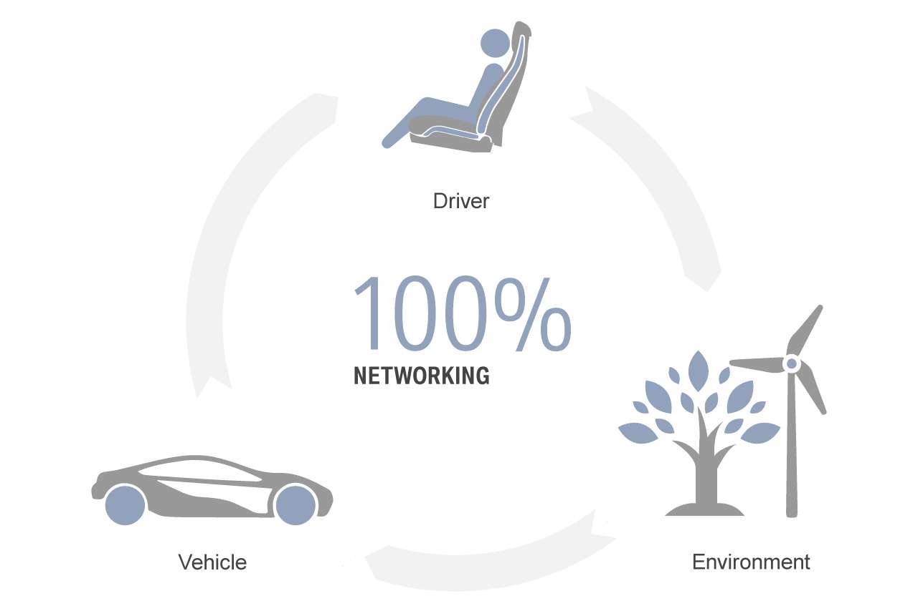
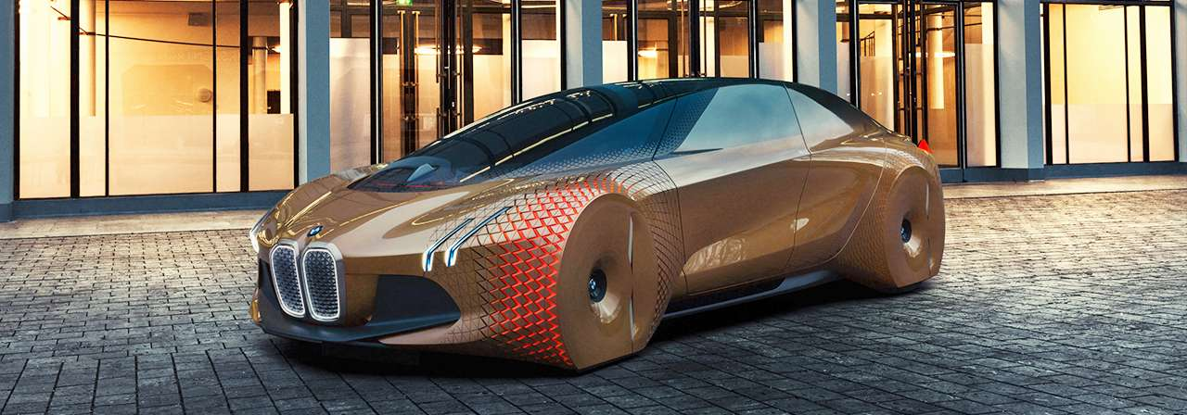
Product Differentiation
The way to deal with highly competitive market is by bringing out a radical innovation in front of the customers.
BMW is already having brand image of quality and the company plans to maintain it. Due to this the customer base in going to change only in terms of generation but not in terms of affordability.
Using differentiation as a strategy to target the pre-established customer base would help BMW to gain focus on the kind of products they need to focus on. This would ensure in what all product areas where features of IT are most important.
BMW ‘The Vision’ combined with ‘Project AI’
Conceptual model launched with new features implementing the use of AI
Enabling AI to influence the emotions of the customers
Upgrading BMW Operating System 7.0 to BMW Operating System 7.0 AI

Slide 51
Scenario Planning
Looking closely at the changing market for understanding future implications
After the impact of the pandemic, the BMW Group needs to focus on how the changing processes and investment in IT would cause their position to change in the market
Apart from forecasting and process efficiency, one of the key factors is keeping a track of the financial stability because IT is not cheap
BMW is currently able to meet its CO2 emission target early which proves to be a strong point in terms of strategic decisions. The next step should be to implement the strategy to focus on energy consumption by the facilities and then the vehicles.
BMW investment needs to be planned in such proportions that liquidity position remains strong to support the R&D development and dealing with substantial upfront costs
As per forecast, the automotive sector needs to be prepared for a decrease in delivery year-on-year. This forecast demands for either a major innovation in the product or to support incremental innovation along with cost cutting by enabling IT with operating processes.
BMW needs to plan how the initial investment in IT would affect their present market conditions and need to calculate the Break-Even point.

Slide 52
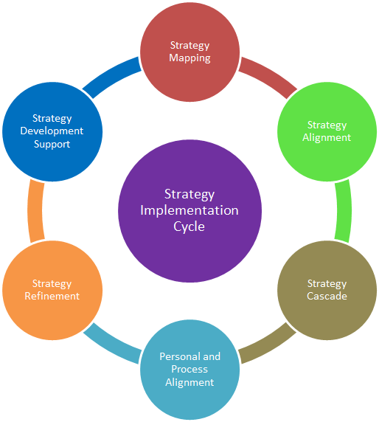
Alignment with Corporate and Business/service unit
Implementation
Ensure IT goals do not compromise with the business needs
Ensure availability of tools and sufficient training to the employees to identify the areas where IT and to exploit its benefits
Implement Small Incremental Changes in products and processes which are tethered to technology
Developing IT related goals and integrating IT tools with all the required departments
Simulation of manufactured products and routing-based decisions both external and internal to the facility
Inculcate a culture of TQM for enabling the continuous use of predictive maintenance

Slide 53
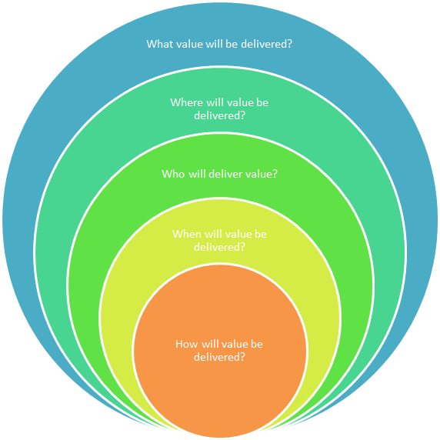
Value Proposition
What value will be delivered?
Highly customized product and service
Eco-friendly and high-quality sophisticated performance
Ensuring transparency in the processes in front of customers’ eyes
Where will value be delivered?
Showrooms
Online website and personalized assistant
In the product itself
Who will deliver the value?
Brand
Personal Assistant provided through BMW Operating Systems 7.0 AI
Employees
When will value be delivered?
When BMW successfully integrates AI with the product, service line and global operations
How will the value be delivered?
Radical innovation for disrupting the market
Providing knowledge to customers to help them access the variety of services offered
Full strategic alignment achieved with IT

Slide 54
5 Principles of Delivering Value
Portfolio Management Processes
Keep a track of progress of Project AI
Revisit the process if some changes are required considering the changes in the external environment
Chunks of Value
Keep a track of status of integration of AI with the process and eliminating bottlenecks
Keeping customers informed about the major change occurring and providing them with short term benefits being implemented in the product
Holistic Orientation of Technology Value
Train employees and make them prepared with the changes occurring in the processes
Start running trails of the features being installed in the products
Equal participation of CIO and CEO and preventing any conflict to arise
Joint Ownership of Technology Initiatives
Keeping all the stakeholders informed about the progress of the project and the issues which might be occurring
Experiment More Often
Proper testing being done and keeping the employees informed about the results of the test
Keep reminding the employees about strategic objectives and value to be delivered
Maintain relationship with the suppliers and distributors and working closely with them at a pace which could enable transformation
Keep a track of measures of the changes occurring due to implementation of AI and using DSS wherever required to enable faster decision making
Conducting Beta testing and keeping a track of customer satisfaction

Slide 55
Digital Strategy
Digital Tools
Website enabling product experience using AR and allowing customers to access their vehicles features
Application being developed for accessing internal features of vehicle and customizing them as per their requirements
Articles, Blogs and Social Media being used to keep the market informed about the changes and influencing customers and competitors
Development
Implementing DSS for providing quick response from business to consumers and vice-a-versa
Keeping a standardized design of process to integrate them with external partners
Creation of digital platform within the company and supporting centralized structure for having command over critical decisions
Developing responsive support systems and database
Business Perspective
Generating dashboards for departments to reduce the physical contact points and making the flow of information digital
Provision of analytical tools for supporting key decision making and forecasting

Slide 56
Digital Strategy
Aggregation of Departmental Wise Requirements
Operations:
Dashboard
DSS
Routing Network
Testing Software
Working Software
Marketing:
Analysis and Data Visualization tools
Customer Measurement Metrics
Accessibility to Multiple Platforms
PR
Finance:
Ratio Calculator
Market Tracking and Analysis
Audit Software
Human Resources and R&D:
Prototype Development Tools
Simulation Tools
Employee Satisfaction Tools

Slide 57
Cloud Strategy
Assess CSP
Adopt Cloud Platform
Process Connectivity
Customer Integration
Business Drivers
Portfolio Analysis
Benefits & Timelines
Virtualization
Customer Resource Management
Create Hybrid Clouds
Consumer Saas
Generation of KPIs according to cloud
Migration of data to cloud
Providing knowledge to the customers regarding cloud
Enabling product and features connectivity to the cloud
Integrating AI with the cloud for improving decision making
Business Maturity
Maturity of new process
Monitoring and Controlling Integration
45%
80%
Initiation
(6 Months)
Reaching Maturity
(36 Months)
Long Term

Slide 58
Cloud Strategy for Adoption
Generation of process KPIs for cloud intergation
Training and technical service
Uploading data to cloud
Generation of dashboards for keeping track of performance
Integration of cloud and product
Cost Analysis and effectiveness
Customer accessibility
Generation of support services and backup

Slide 59
Business Improvement and Competitive Advantage
Quality Improvement
Customer Reach
Predictive Maintenance
Efficient manufacturing process
Customized service
Track of machine analysis and breakdown
Sustainability
Market reach and penetration
Improved response time
Analysis of product breakdown and identification of areas requiring improvement
Less service requirements enabling cost saving
Strengthening brand image
Government support
Positive image in market and gaining slight share of empathy
Business Improvement
Improved decision making
Better connectivity across various departments
Timely monitoring of processes

Slide 60
IT-Business Relationship
Competence
Gaining expertise over AI and dominating autonomous products industry
Ability to use IT for revenue generation and passing break-even point
Credibility
Maintaining transparency between internal operations and customers
CEOs and CIOs working hand-in-hand to ensure business efficiency
Interaction
Reduction in conflicts and politics due to proper information sharing
Since project AI is a company’s deciding project, it enables professionalism
Trust
Operationalizing the strategies generated based on AI
Monitoring ensuring support to business touchpoints
Enabling proper track of information using IT helps in reducing hierarchical structure
Trust between departments by having a decentralized structure
Highly customized products helps customer to open-up to the company
Sense of trust between IT and profits

Slide 61
Use of Information Management
Collect, Create and Capture
Use and Dissemination
Maintenance, Protection and Preservation
Retention and Disposition
Information Management
Collect, Create and Capture
The user data is collected based on number of permissions granted form the side of the customer.
The data is then combined with the analytical findings of BMW and the R&D department to support further innovation
Key data is captured such as IP address and number of clicks, etc. which enables BMW to understand what the customers are interested in location wise.
Use and Dissemination
The collected data is used in the form of inputs for the various departments in the company for enhancing their operations
Project AI uses this data to provide much better services to the customers and to improve automation along with BMW Operating System 7.0 AI
Maintenance, Protection and Preservation
Data privacy statement is provided to all the customers and permission is gained before sharing any data to third party service providers.
Adhering to FCPA regulations (Foreign Corrupt Practices Act)
Retention and Disposition
The data is stored in secure database at BMW and only the data which has been allowed by the user to be stored. If user does not feel comfortable then the data is removed

Slide 62
Master Data Management
R&D
Sales and Marketing
Operations
Customer Service
Information Management
Org. Policies and Key data
Market Data
Data regarding products, services, etc.
MDB
Provides AI based response
Project AI
Accesses Data
Key Information Stored
Centralised Database
Vehicle(Personal Assistant)
Blogs and Social Media
Websites
Showrooms
Customer
Visits/Enables Information Sharing
Recommendations

Slide 63
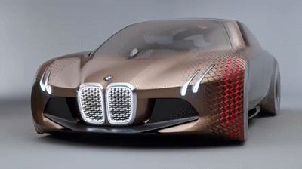
IT-Enabled Innovation
Improving Customer Service
AI based personal assistant is used to collect real-time customer data as soon as a customer uses his/her vehicle. This helps to improve autonomous vehicle functionality and helps in monitoring customer needs
The accessibility provided to customer for demanding customized product and to fulfil those requirements is becoming more easy due to a drastic increase in features supported by AI
Quick response to customer queries and ensuring physical safety and security
Using Business Intelligence: Automotive Sector and Customer Analysis
BMW is radically changing the automobile market with the help of AI that too in a much sustainable way
Development of The Vision next 100
Automizing control over energy consumption enabling process change
Analysing pattern in purchase of customers, The frequently used command by Personal Assistant.
Average distance being travelled helping in designing a much detailed navigation system

Slide 64
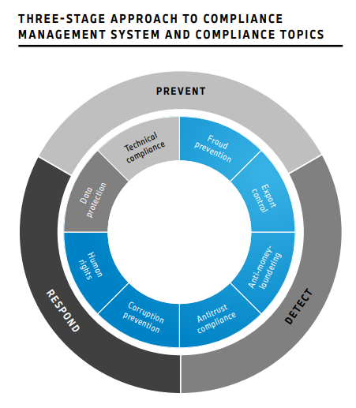
Compliance

Slide 65
Compliance
External
Internal
User Accessibility
Documentation and maintenance of customer requests
Data breach and management
Data Management Standards
Customer consent and permission before collecting data
Adhering to FCPA regulations (Foreign Corrupt Practices Act)
Project AI specific requirements of data type
Vehicle performance and features efficiency

Slide 66





Suppliers and Alliances
Requirements
Vendor Search
Develop RFP (If needed)
Vendor Proposal Evaluation
Contract Negotiation
Quality
Scalability
Market Image
Installation procedure
Software ease of integration
Safety Factor (Testing Reports)
Evaluation Criterion

Slide 67
IT Governance
IT Governance
Strategic Alignment
Performance Management
Resource Management
Value Delivery
Risk Management
Strategic Alignment
The strategies in the organization should be aligned with the existing organizational goals.
Performance Management
The performance metric of all projects and employees should be monitored and documented.
Resource Management
Allocating resources in IT should align with the current strategy and the vision of the organization.
Value Delivery
The value of money of the product/service delivered is crucial for customer satisfaction.
Risk Management
Analysis of risk, its impact, its likelihood and the strategies for risk management.
Strategic Alignment
The strategies in the organization should be aligned with the existing organizational goals.
Performance Management
The performance metric of all projects and employees should be monitored and documented.
Resource Management
Allocating resources in IT should align with the current strategy and the vision of the organization.
Value Delivery
The value of money of the product/service delivered is crucial for customer satisfaction.
Risk Management
Analysis of risk, its impact, its likelihood and the strategies for risk management.
IT Strategy

Slide 68
IT Governance
Corporate and Key Asset
Managing the Shareholder
Operational
Managing technology and information
Finances and Portfolios
Strategy
Risk Management
Project planning and monitoring
Disclosure of information to the board
Understanding departmental contributions and aligning them
Execution and Projects
Standards and governing policies
Organizational change impact
Process, IT and Control impact

Slide 69
Risk Assessment
Level | Likelihood | Expected or actual frequency experienced
1 | Rare | May only occur in exceptional circumstances; simple process; no previous incidence of non-compliance.
2 | Unlikely | Could occur at some time; less than 25% chance of occurring; non- complex process and or existence of checks and balances.
3 | Possible | Might occur at some time; 25 – 50% chance of occurring; previous audits/reports indicate non-compliance; complex process with extensive checks & balances; impacting factors outside control of organization.
4 | Likely | Will probably occur in most circumstances; 50 -75% chance of occurring; complex process with some checks and balances; impacting factors outside control of organization.
5 | Almost Certain | Can be expected to occur in most circumstances; more than 75% chance of occurring; complex process with minimal checks & balances; impacting factors outside control of organization.

Slide 70
Risk Assessment Matrix
Risk event | Likelihood | Impact | Detection Difficulty | Score | When
Technological risks | 4 | 5 | 3 | 60 | Whole Process
Quality of Service | 2 | 3 | 2 | 12 | After deployment
Integration of AI | 3 | 5 | 3 | 45 | During the process
Energy Management change process | 2 | 3 | 1 | 6 | Initiation Stage
Policy and legal risks | 3 | 5 | 4 | 60 | After deployment
Lack of Vendor support | 1 | 3 | 2 | 6 | Initiation Stage
Information Flow | 5 | 4 | 2 | 40 | Whole process
Hardware compatibility cost | 2 | 5 | 5 | 50 | Initiation Stage
Market risks | 3 | 4 | 2 | 24 | During the process

Slide 71
Risk Management
Risk event | Response | Consequence of risk | Contingency Plan | Risk Cause
Technological risks | Requires more analysis and right way to implement it | Reducing the profit compared to investment by huge margin | Incremental Innovation rather than going after radical one | Unfamiliarity to different existing technologies in market
Quality of Service | Giving personalized attention to customers | Deterioration in business and brand name | Continuous evaluations and follow ups done by the company | Not able to analyze the right needs that needs to be satisfied
Integration of AI | Integrating in a step-wise manner. Starting from the basics | Improper use of resources and wastage of time | Maintaining a threshold value for different stages of the project | Unfamiliarity with the technology and business processes
Energy Management change process | Looking for other ways to manage energy and diverting investment towards new equipment | Infrastructure loss | Changing the process in terms of Lean or TQM | Lack of maturity of facility and equipment compared to new methods
Policy and legal risks | Immediate response required | Legal consequences, media being involved and brand name in jeopardy | Improvising process involved in business requirements through all parties involved in the project | Unplanned way or neglecting the necessary legality involved
Lack of Vendor support | Giving personalized attention to vendors | Delayed deployment and funding alteration | Legally bound vendor | Approach by a competitor or budget involved
Information Flow | Immediate meeting being held | Wastage of resources and time involved | Ensure proper connectivity and digitization | Lack of attention and focus on data analysis
Hardware compatibility cost | Proactive approach before deployment | Wastage of resources, money and time involved in the process | Looking alternatives and ways to integrate the hardware | Unforeseen circumstances and highly demanding technology
Market risks | Immediate response required | Loosing customers | Market analysis and pre-surveys required for both customers and competitors | No pre-survey of data before beginning the project

Slide 72
Communication Plans
Event/Activity | Objective | Medium | Contributor(s) | Audience | Frequency
Business Management Meeting | The major stakeholders, CEOs and CIOs would be meeting for discussing the further market implications and strategizing the project | Virtual or Physical meeting. (Face-to-Face preferred) | CEOs, CIOs PMs | Stakeholders | Monthly
Team Formation and Briefing Session | Assigning roles and responsibilities and solving any queries | Physical meeting | PMs, CIOs | Project team members | Once
Risk Analysis | To progress a risk, issue, dependency or assumption that cannot wait until the regular weekly meeting. | Brief meeting with conference call if required. | Raiser of risks, issues, dependencies and assumptions | Program Management Team | As Required
Department Meeting | To communicate decisions and getting inputs from all the department heads | Virtual or Physical meeting. (Face-to-Face preferred) | CEOs, CIOs, PMs and PM team | Department heads and members | Once and later as required
Status Meeting | To provide an overview of the current status of an individual project a focus on plans, Risks, Issues, Dependencies and Assumptions (particularly those that need to be escalated) and financials. | Email (with chart) | Project Manager and Project team | CIOs and Department Heads (CEO in CC) | Weekly - Monday
Supplier and external parties meeting | Supplier engagement meeting and informing about the occurring change and requirements from their side | Virtual Meeting | CEOs, CIOs, PMs | All suppliers | Once and later as required
Review Meeting | To inform regarding the status of key deliverables | Virtual or Physical meeting. (Face-to-Face preferred) | PM team | CEOs, CIOs and PMs | Every two weeks
Emergency Meeting | To mitigate the risk or to solve a problem having a major impact | Virtual or Physical meeting. (Face-to-Face preferred) | Project Team, Department Heads | CEOs (If required), CIOs, PMs | As Required

Slide 73
Reporting Matrix
 | Level 1 | Level 2 | Level 3
Reports submitted to | Work stream/Team Leaders | Project Manager | Steering Committee/Project Sponsor
Purpose | Status and progress of individual tasks and deliverables Future planning related to upcoming short-term tasks New and outstanding issues and risks | Status of business unit tasks and deliverables Milestones completed and upcoming New and outstanding issues and risks Project costs (forecasted vs actual) | Progress report on key/critical milestones and activities Major risks/issues Rise of potential conflict with the major players
Level of Detail | Task level detail | Work stream level detail | Program level detail
Responsibility | Individual Project Team members | Business Unit Project Manager | Project Manager
Frequency | Weekly | Weekly or as determined by Project Manager | Bi-Weekly
Format | Project Status report e-mailed to Project Manager Verbal presentation during weekly team meeting or as determined by Project Manager | Project Status report e- mailed to Project Office prior to meeting Verbal presentation during meeting | • Executive dashboard/KPI delivered during the Bi-Weekly presentation

Slide 74
Professional Assessment

Slide 75
External Analysis: Ansoff Matrix
Market Penetration
Product Development
Diversification
Invest in Artificial intelligence technology to develop automonous smart cars
Educate existing customers towards new products and services
Produce smart cars that can communicate with one another
Subscription based WIFI & streaming service for cars
Use AI to develop data driven on demand customer features
Use data to understand customer needs for creating customized cars
Build real-time data insights for customers like using car sensors and satellites to provide traffic and weather patterns or using customer preference to provide restaurants and shopping choices.
Build subscription-based charging station infrastructure for electric cars
Increase the radius of the target market beyond current professionals
Market Development
Develop Eletric cars with batteries that can autocharge
Use AI based data to understand new market segments and localized services to specific customer ethnic communities
Continue to invest in marketing and advertising to increase market penetration
Use technolgy to offer existing customers option to shop using Virtual Reality
Use technology and IT to quickly develop next generation models 2-3 years vs 5-10 years
Boost automotive sales using AI technolgy
Reduce operational cost and improve resiliency by employing technology and IT
Existing Products
New Products
Existing Market
DECREASING RISK
New Market
DECREASING RISK

Slide 76
Porter’s Five Forces (Overall it’s a profitable industry)
Threat of New Entrant (Low)
Economies of scale can only be offered by big players in auto industry. Threat of new entrants is low
IT Infrastructure is mostly managed inhouse and has minimal control by suppliers however there could be forward integration from players like apple who currently offer apple car play
Threat of Substitutes (Medium)
Customers using alternate travel methods like subway, buses and air-travel can be substitute in certain metro regions
Threat of substitute in suburban countries is low as Cars are the only option for short distance travel.
Bargaining Power of Consumers (Low)
Premium Auto industry is a competitive market and hence it’s a medium risk for sales
Overall auto industry growth rate is expected to further reduce from 3.6 to 2 percent
Auto consumers in premium car market have many options to switch and hence consumer bargaining power is high
Customer brand loyalty reduces bargaining power
Strong brand awareness and loyalty to major players hence threat from new entrants is low
Differentiation of high quality driving machines in premium car market reduces consumer bargaining power
Competitive Rivalry (Medium)
Bargaining Power of Suppliers (Medium)
Global Chip shortage has created pressure on automakers supply chain and hence threat has increased lately
Size of auto industry competing firms is large but each firm competes for different market segment
Large amount of capital required for new entrants hence its low threat

Slide 77
As-Is / To-Be Analysis
 | Business Strategy
Business Scope |  | AS-IS | TO-BE
 | Products and Services | Ultimate high performance driving machines with superior engine performance and state of the art technology packages | Offer Smart and fuel-efficient mobility auto solutions with value added features that ties its customers to subscription-based loyalty model and superior customer experience.
 | Customer/Clients | Professionals, age based and high-income groups | No change in the present audience. Continue to target high income groups however also attract diverse age groups and communities and global regions
 | Competitors | Mercedes Benz, Audi, Porsche, Chrysler-Fiat, Lexus | Mercedes Benz, Audi, Porsche, Chrysler-Fiat, Lexus, Tesla
Distinctive Competencies | Competencies | Core technology and superior engine Powerful Brand Recognition Over 100 years of experience in auto industry Global Network of supply chain and product sales Superior R&D process | Invest in AI technology and data transformation strategy to gain competitive advantage over its competitors Customer centric model that allows customized auto mobility solutions Premium auto industry market dominance

Slide 78
As-Is / To-Be Analysis
 | Business Strategy
Business Governance |  | AS-IS | TO-BE
 | Internal Decisions | “BMW Group strategy” defines the framework for decision-making and lays the foundation for the Company to maintain a consistent focus on profitability, growth and sustainability, in an increasingly dynamic environment." | No change anticipated to the internal decision-making strategy
 | Regulatory | Compliance with regulatory requirements as a factor for business decisions related to vehicle projects, Targets for fleet carbon emissions are also taken into account. | No change in strategy
 | Partners | Existing Partnerships with PUMA, Pennzoil, Quaker State, Shell Helix, Apple, BorgWarner, Mahle, Bridgestone, Google, Delphi, Guardian, Harmon Kardon, Brembo, HYSSENKRUPP for high quality cars and high-end technology | Explore alliance with major electric cars battery makers like CATL, LG Energy , Panasonic, Samsung SDI

Slide 79
As-Is / To-Be Analysis
 | Business Infrastructure
Key Processes | AS-IS | TO-BE
 | Commitment towards resource efficiency in production Commitment towards reducing CO2 emissions Manufacture using fully reusable and recoverable components Serving as a platform to produce ultimate driving machines Build processes aimed at improving the firm's compliance management system on a continuous basis. | Build intelligent workflows Use Artificial Intelligence and data digitization / transformation to improve corporate decision-making process Automate engineering processes through digitization and artificial intelligence
Human Resources | Centralized health and occupational safety management of human resources Attract skilled employees, efficiently optimizing their deployment and providing them with learning opportunities to develop their full potential to meet the firm's objectives | Target diversity in building human resources Create work environment that promotes inclusion, safety and wellbeing of all its workers Build infrastructure for employees to work virtually and flexible working hours

Slide 80
As-Is / To-Be Analysis
 | IT Strategy
Technology Scope |  | AS-IS | TO-BE
 | Key Applications | Mobile application that allows Remote start, vehicle controls, health check and safety recalls Vehicle on screen computer displays and voice command software Computer controlled software for transmission shift | Use AI and Hybrid cloud to build applications to cut costs and optimize operations. Build AI based applications that provides untapped data that can gain deeper insight into customers, capabilities and providing personalized customer experiences, smart travel and onboard controls
 | Key Technologies | Autonomous driving and sensor-based parking and braking Remote Valet parking | Level 5 autonomous driving, electric vehicles, prolonged battery level, self-charging batteries, Vehicle digitalization, digital operating systems, driver assistance technologies and personalized digital experiences using Virtual Reality, dynamic parking
Systemic Competencies | Competencies | Drive system technology Electrified vehicles BMW Group Battery Cell Competence Centre Research and Innovation center in Munich | Autonomous driving campus built to produce level 5 autonomous driving. Key partnership with Intel, Mobileye and advanced battery manufacturers etc. to produce fully electrified, digitized autonomous driving cars Human Resources that can help BMW build next generation cars
Governance | Governance and Compliance | Customer Data privacy and data management standards Data is fragmented and complex across the organization Adhering to FCPA regulations (Foreign Corrupt Practices Act) | Project AI specific requirements of data type, build ethical standards for rules engine and client's privacy

Slide 81
As-Is / To-Be Analysis
 | IT Infrastructure
Architecture | AS-IS | TO-BE
 | BMW e-Drive Technology architecture Superior high-performance engines | Architecture will focus more on building electrified or fuel-efficient hybrid vehicles and promoting artificial intelligence-based software architecture
Key Processes | BMW Group Battery Cell Competence Centre Research and Innovation center in Munich Autonomous driving campus | Continue to leverage the current IT infrastructure of research and innovation center in Munich Aligning IT strategy with business goals Big data tapping infrastructure AI and ML Integration for predictive analytics
Human Resources | Focused IT Human Resources | Train and diversify the human resources to build skills around big data, artificial intelligence, IOTs

Slide 82
Market Analysis and Demand
Global Auto Industry CAGR 3.71% (2020 – 2030)
85.32 Million Units in 2020 to 122.83 Million units by 2030
American market is $713.07B in 2021 to $970.23B in 2027
BMW expects that by 2030 more than 50% of its global deliveries will be fully electric.
The luxury premium car industry is a differentiated oligopoly as each firm targets vehicles with different features and audiences
Notes:
https://www.yahoo.com/now/global-automotive-market-analysis-outlook-100300546.html
https://www.Google.com

Slide 83
Market Analysis and Demand - Global Automobile Markets Change compared to previous years
Region | Growth Trend
Europe | -2%
USA | 3%
China | 3%
Japan | -3%
Total | 1%
Notes:
https://www.yahoo.com/now/global-automotive-market-analysis-outlook-100300546.html

Slide 84
Market Analysis and Demand - BMW Deliveries of electrified cars
In Units | 2021 | 2020 | Change in %
BMW Group PHEV* | 224,460 | 148,121 | 51.5
BMW Group BEV* | 103,854 | 44,541 | 133.2
Total | 328,314 | 192,662 | 70.4
*PHEV --> Plug in Hybrid Electric Vehicles
*BEV --> Battery Electric Vehicles
Notes:
https://www.yahoo.com/now/global-automotive-market-analysis-outlook-100300546.html

Slide 85
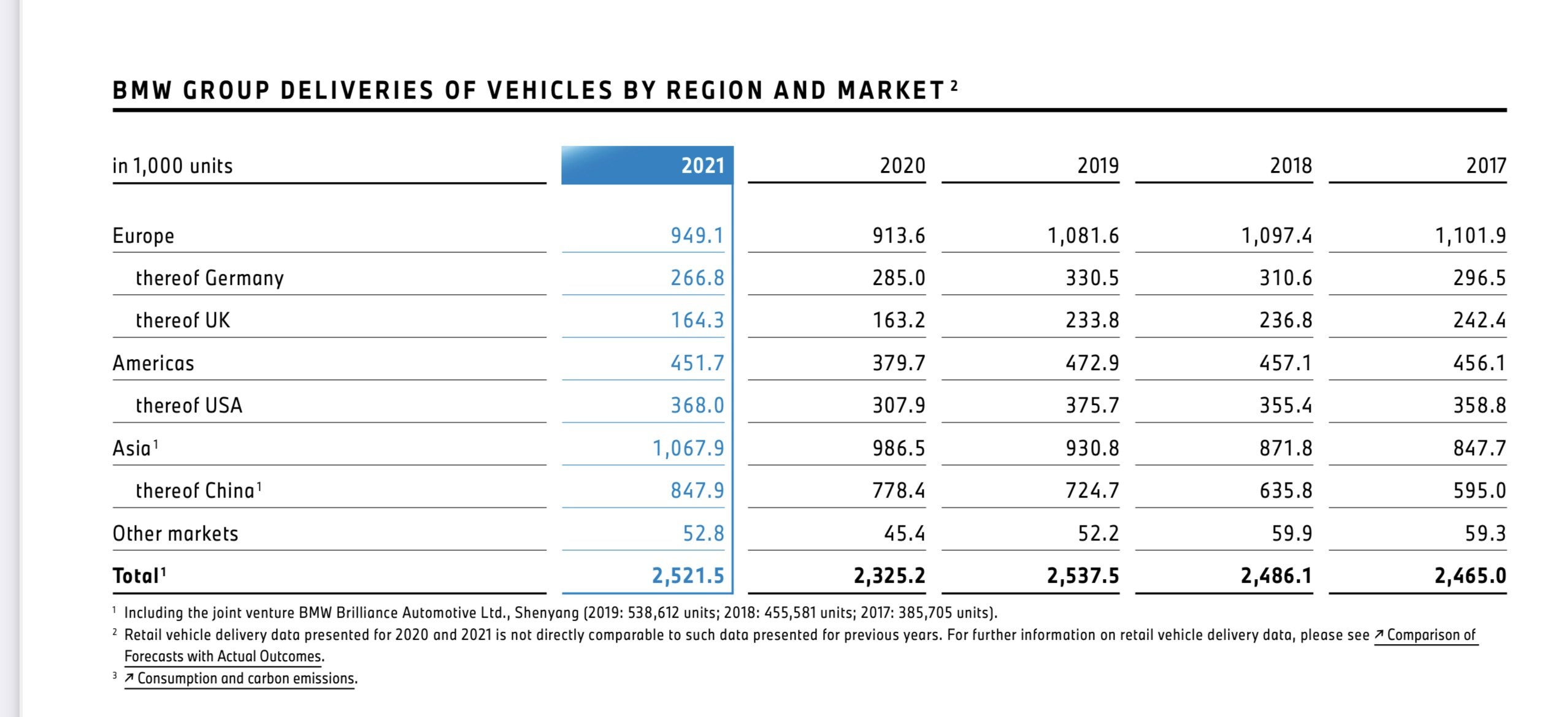
Market Analysis and Demand - BMW Deliveries by Region & Market
Notes:
https://www.yahoo.com/now/global-automotive-market-analysis-outlook-100300546.html

Slide 86
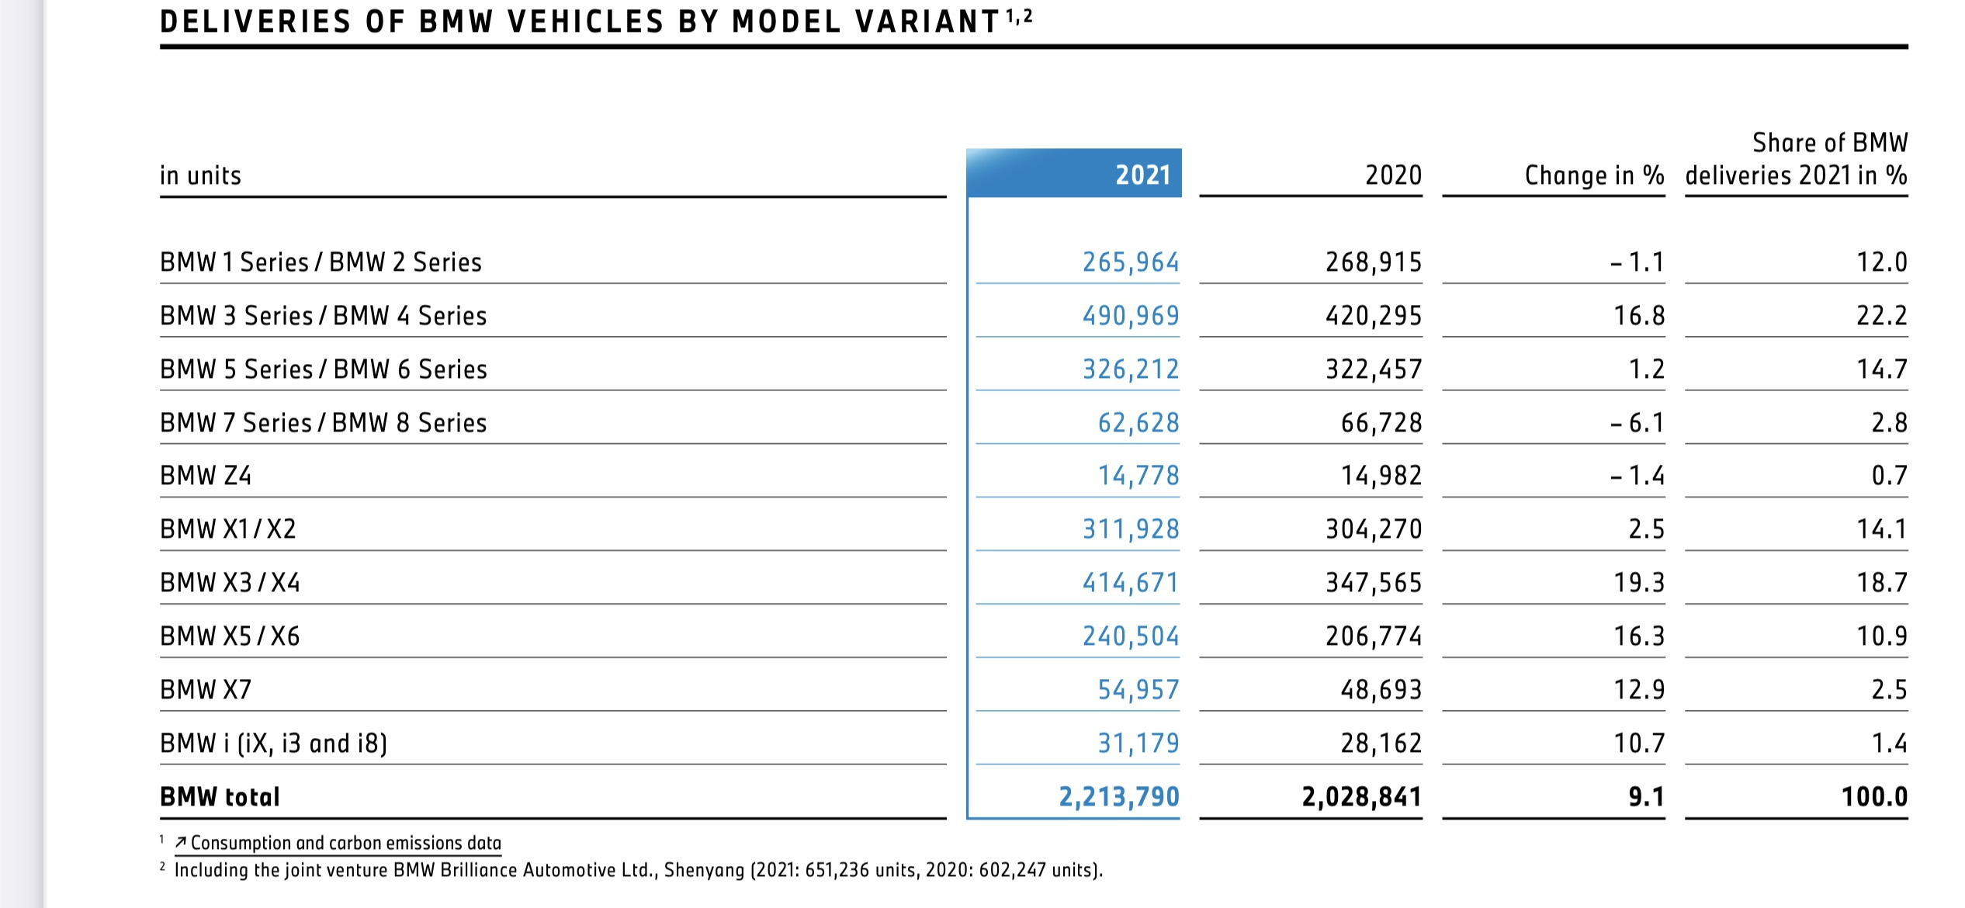
Market Analysis and Demand - BMW Deliveries by Model
Notes:
https://www.yahoo.com/now/global-automotive-market-analysis-outlook-100300546.html

Slide 87
Target Markets
High Income Customers
35 %
“BMW is fortunate-we don’t have too much of a dilemma as to what we’re going to call our cars.” – Jim McDowell, Vice President of Marketing at BMW
Brand conscious Customers
20 %
Existing Customers
20 %
“BMW is such an iconic brand. The fact that I get to be the face of this campaign is definitely a career highlight for me. The M2 is such a cool, fun car. I had a blast working on this project. - Gigi Hadid
Cool and Fun Car Drivers
15 %
Tech Savvy Customers
5%
“BMW is eager to widen their potential audience by creating content that engages consumers beyond cars and “gets to the point”. Global Head of Digital Marketing, Jorg Poggenpohl
Green environmentally conscious Car drivers
5 %

Slide 88



BCG Matrix
Market Share
Autonomous driving EV fully-electric luxury cars for example SUV BMW iX will become the future star for BMW
High
Low
Star
Question Mark
- BMW existing gas-powered SUVs continue to be the question mark for its future growth as there is a trend to move towards more eco-friendly vehicles.
Growth Rate
High
- BMW 3 series sedans and Rolls Royce are the cash cow for BMW - M series sports performance cars will also continue to be future cash cow for BMW
Low
Cash Cow
Dog
BMW z4 sales are still low and are identified as dog for BMW group

Slide 89









BMW Positioning Maps
High Price
Low Quality
High Quality
Low Price
Notes:
Logos extracted from google.com

Slide 90
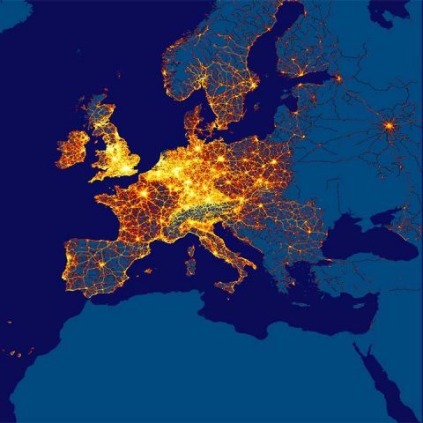
BMW Group Data Ecosystem
Notes:
Extracted from bmwgroup.com

Slide 91
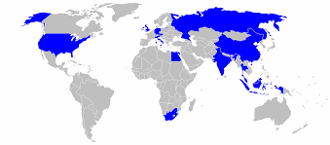
World Locations of BMW Group Factories
Notes:
Extracted from commons.wikimedia.com

Slide 92
IT Service Design

Slide 93
Stages of the Service Design
Stage 1: Defining design attributes
Stage 2: Specifying performance standards
Stage 3: Generating and evaluating design concept
Stage 8: Improving performance
Stage 4: Developing design details
Stage 5: Implementing the design
Stage 6: Measuring performance
Stage 7: Assessing satisfaction
Notes:
http://www.yourarticlelibrary.com/company/service-management/service-design-components-methodology-and-overview-of-model-stages/40557
**https://wiki.en.it-processmaps.com/index.php/ITIL_Service_Design

Slide 94
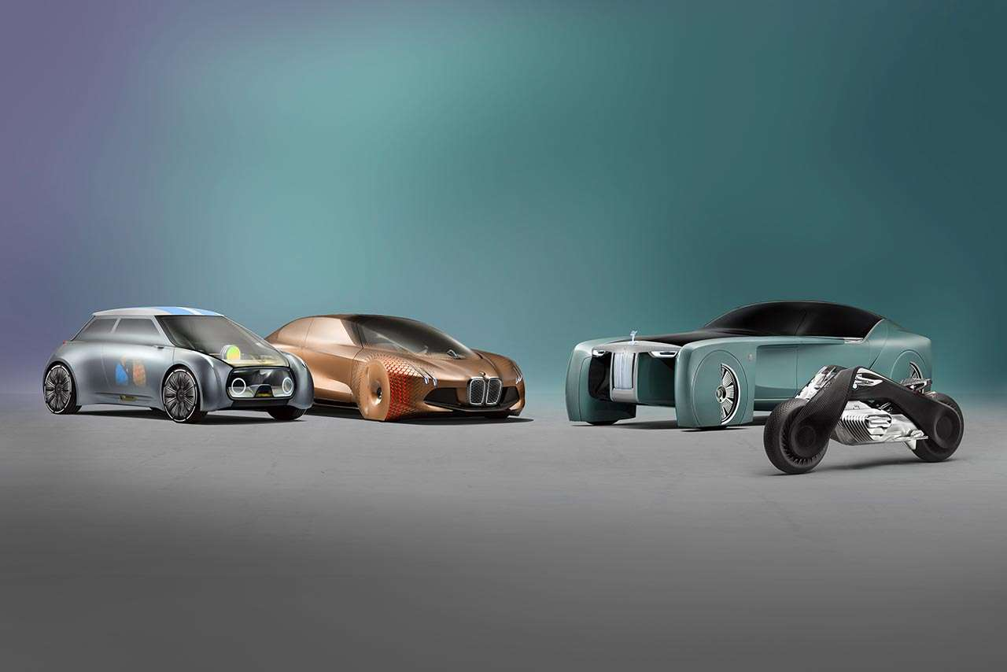
Productivity and Innovation
BMW initially specialize in building premium automobiles, motorcycles, and mobility solutions.
It introduced an ability to AI based energy management in vehicles to reduce CO2 emission.
Innovation in the Production phase by using automated image recognition through AI to evaluate component images and dust particles in the paint shop.
The BMW increasing the customer experience by developing Driver Assistance and BMW intelligent personal assistant.
Notes:
https://www.forbes.com/sites/adrianbridgwater/2017/01/11/stack-overflow-joel-spolsky-how-to-build-a-business-from-a-qa/#2cfd48797adb
https://wiki.en.it-processmaps.com/index.php/ITIL_Service_Design

Slide 95
Service Processes
Consistent Design
Ensures consistent design of new and changed IT services, technology and processes.
Scaling IT services
To ensure that the capacity of IT services is able to deliver in a cost effective and timely manner.
Continuity Management
Ensure continuous delivery with no outage and impacts to customer services
Data Security
Ensure customer and organizational data is confidential and secure
Notes:
https://wiki.en.it-processmaps.com/index.php/ITIL_Service_Design

Slide 96
Service Visualization through blueprinting
Customer Channel
BMW Luxury Cars
BMW Motorcycle
BMW website
Customer Action
Buy and Drive experience
Adventure ride experience
Book car online
Search/Apply for Jobs
Customer Experience
Sheer Driving Experience
Comfortable Ride
Automotive innovation
AI enabled motor vehicles
Safety features
Update dashboards
Feedback Processes
User feedback are recorded
User Data is analyzed
Generate insights

Slide 97
Technology Roadmap

Slide 98
Technology Roadmap
Level 0
Level 1
Hands on, Eyes on, longitudinal or lateral guidance (Achieved Q4 - 1990)
Level 2
Hands temporary off, eyes temporary off, traffic control and longitudinal or lateral guidance (Achieved Q1 - 2010)
Level 3
Hands off, eyes off, awareness for take over, take over request (Target Q4 - 2022)
Level 4
Hands off, mind off, no driver intervention, no take-over request (Target Q3 - 2028)
Level 5
Hands off, driver off, no driver (Target Q4 - 2030)
Hands on, Eyes on (Achieved Q4 - 1928)
We are Here

Slide 99
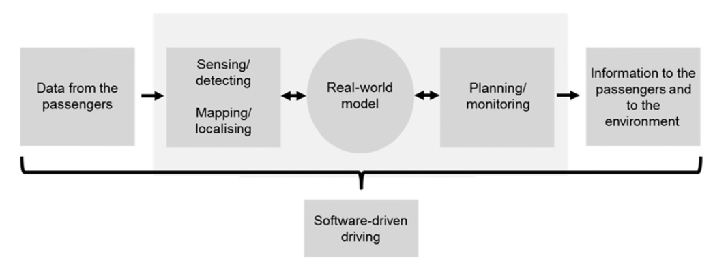
Technology Roadmap (Level-3)

Slide 100
Business Model

Slide 101
BMW's Business Model
Key Partners Stakeholders Employees Management Customers Suppliers Strategic Alliances | Key Activities Product Development Business Intelligence Understand market demands | Value Propositions The ultimate driving machine Cater to drivers that value luxury and performance |  | Customer Relationships Building a customer experience Dedicated teams for market outreach | Customer Segments Urban/Rural Age: 20-65 Professionals & executives
 | Key Resources Employees Vendors Management |  |  | Channels Car dealership Website
Cost Structure R&D, sales, production, marketing and training |  |  | Revenue Streams Automobile, motorcycle, financial

Slide 102
Business Model Alignment
Develop Expertise in
Autonomous Driving
Be a differentiator
Provide excellent maintainence
Vehicle Functions
Supply Chain
Research & Development
Insightful analytics of the automobile market
Personalized customer experience
Consumer's go-to place for automobile needs

Slide 103
Functional Strategies

Slide 104
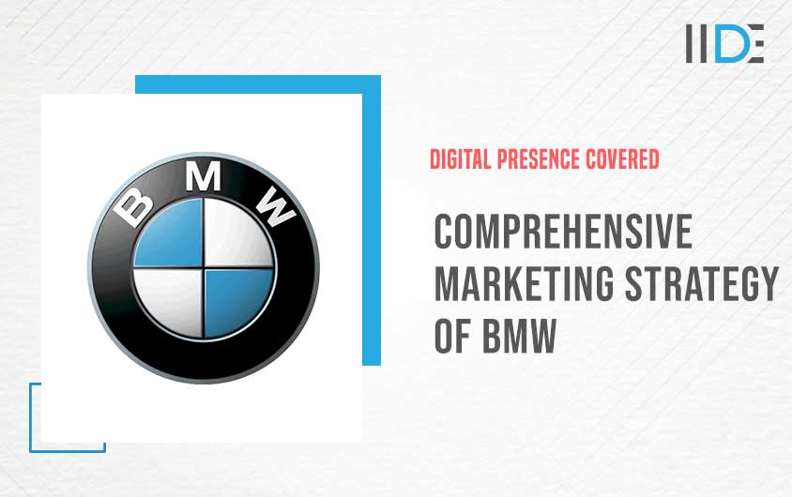
Market Strategy
Artistic Approaches and Creativity is a Must
Ambassador and Proud Presenter of the Latest Technologies
Using Guest Stars in BMW Marketing Campaigns
Net Promoter Score is governed by Word-of-mouth marketing. Leverage that
Showing off The Competitive Side
Deep Knowledge About Who To Reach and How To
Adjust the Campaign Budgets Based on Car-Buying Trends
Include Corporate Social Responsibility in the business

Slide 105
8 P’s of Service Marketing
8 P’s of Service Marketing
Product
Price
Place
Promotion
People
Process
Physical Evidence
Productivity & Quality
Product: Quality, Brand name, Design, Features and Options
Price: Payment terms, Quality/Price
Place: Distribution coverage, Distribution Channel
Promotion: Branding, PR, Personal selling
People: Customers, Internal team/Employees, Internal Management, Competitors
Process: Customer centric approach, IT development, Customer Direction
Physical Evidence: Environment, Layout, Uniforms, Furnishing
Productivity and Quality: Personalized elements

Slide 106
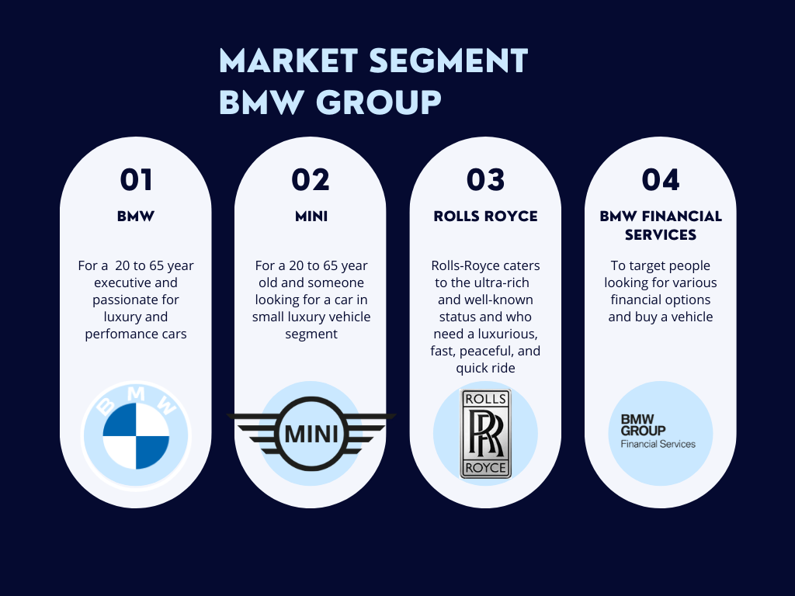
Market Segmentation

Slide 107
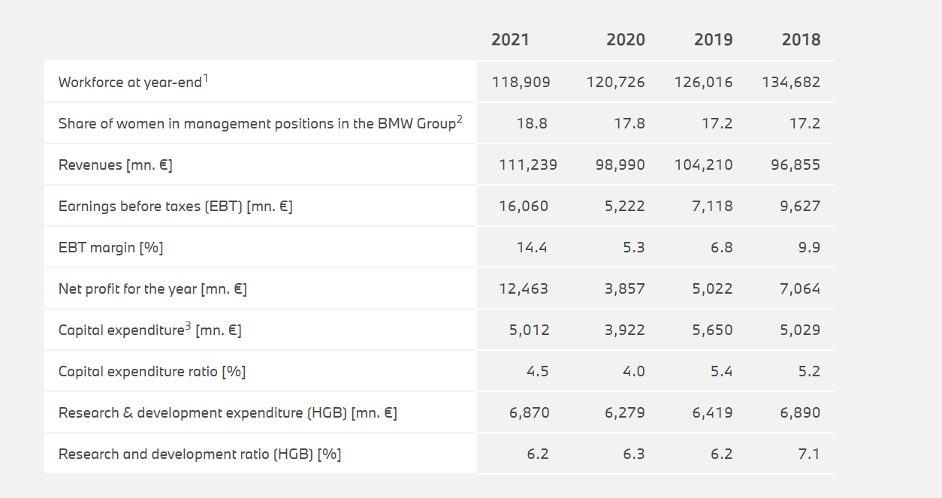
Market Segmentation
Key Figures

Slide 108
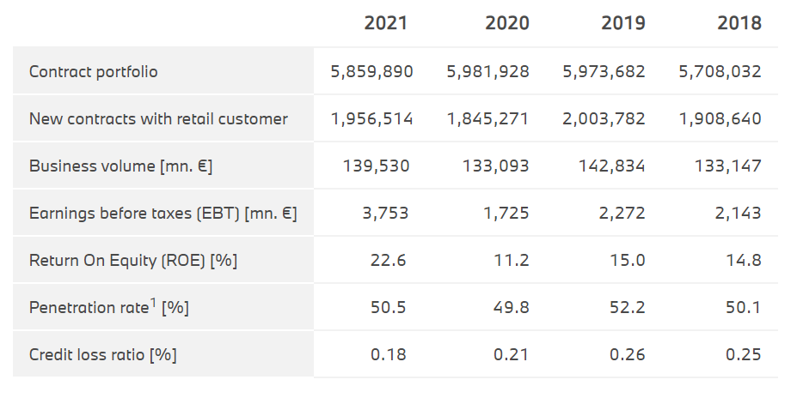
Market Segmentation
Financial Segment

Slide 109
Customer Satisfaction and Loyalty
Customer Loyalty
Improve Customer Experience
Reward Programs
Effectively handle complaints
Dedicated support team on standby
Personalized Services
Word of Mouth promotion
Seek out Competitors
Use Focus Groups
Seek Feedback

Slide 110
Financial
Profit Loss Analysis (in € million)
in € million | 2021 | 2020
Profit / loss before financial result | 13,400 | 4,830
Result from equity accounted investments | 1,520 | 920
Interest and similar income | 135 | 116
Interest and similar expenses | – 165 | – 458
Other financial result | 1,170 | – 186
Financial result | 2,660 | 392
Profit / loss before tax | 16,060 | 5,222
Income taxes | – 3,597 | – 1,365
Net profit / loss | 12,463 | 3,857

Slide 111
IT Capital Budget (€ million)
Project Segments | 2022 | 2023 | 2024 | 2025
Development | 500 | 650 | 1000 | 1000
Testing | 100 | 100 | 350
Training | 100 |  | 50 | 100
Pilot | 300 |  | 120
Deployment | 200 |  |  | 800
Consulting Fees | 200 | 100 | 180
Technology Purchases | 1800 | 1950 | 700 | 1000
Project Development (Total) | 3200 | 2800 | 2400 | 2900

Slide 112
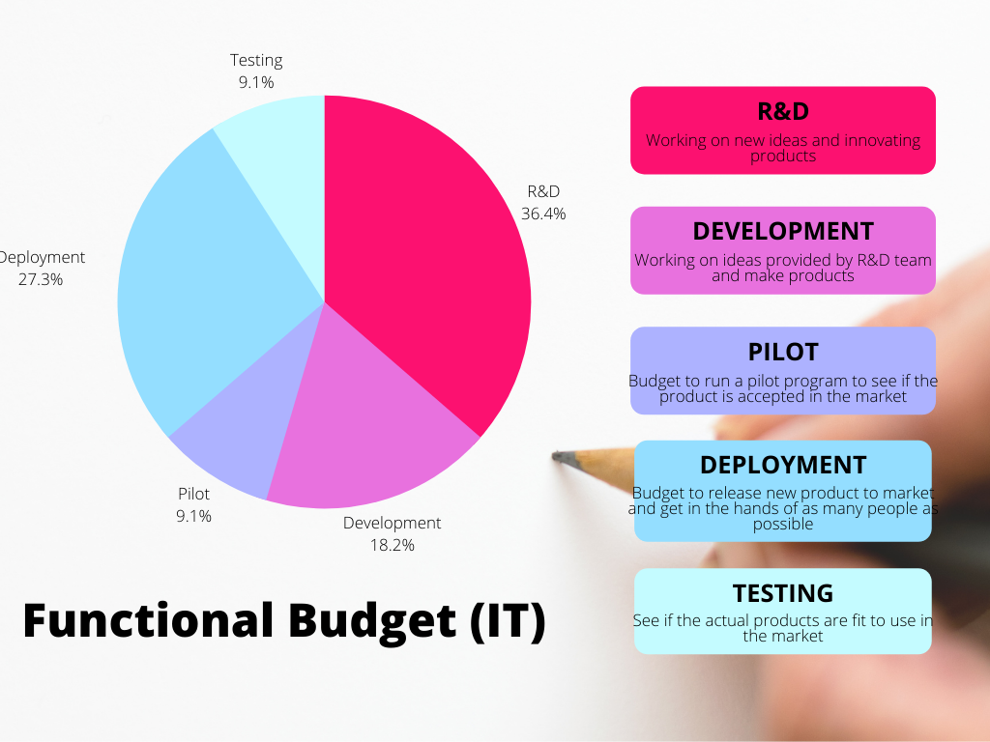
IT Budget (Functional Cost)

Slide 113
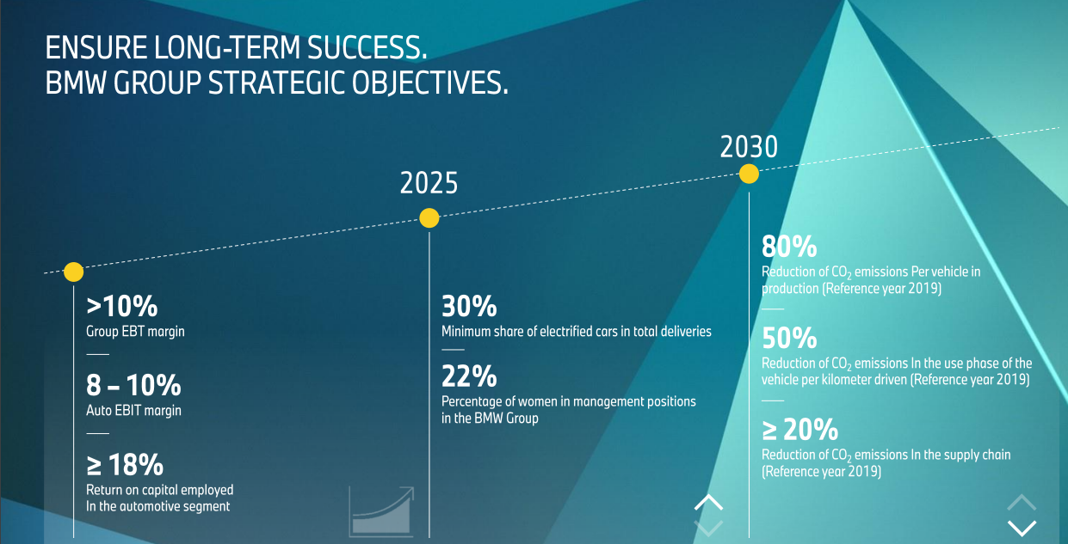
Financial
Forecast

Slide 114

Delivery / Operations
Customer Service Strategy
Be available across the world
Add transparency to supply chain
Ability to purchase online
AI enabled customer assistance
Add personalization to their products

Slide 115

Delivery / Operations
Producer
Dealer
Customer
Distributing services through physical and electronic channels
Current State:
Offline dealership (80%)
Virtual Showroom (20%)
Future State:
The Marcom Engine
BMW digital ecosystem for pre-sales, sales and after-sales

Slide 116
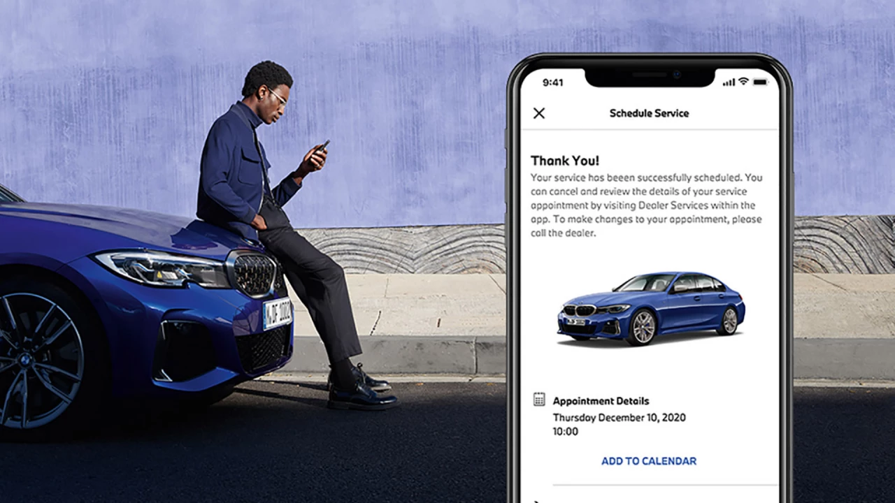

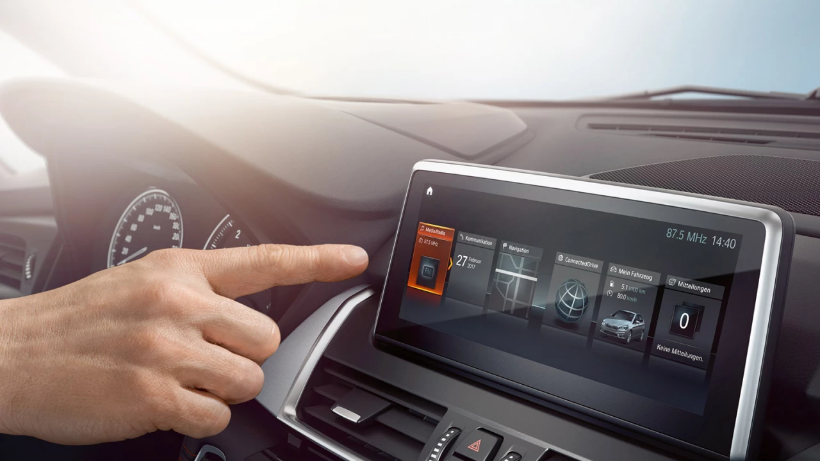
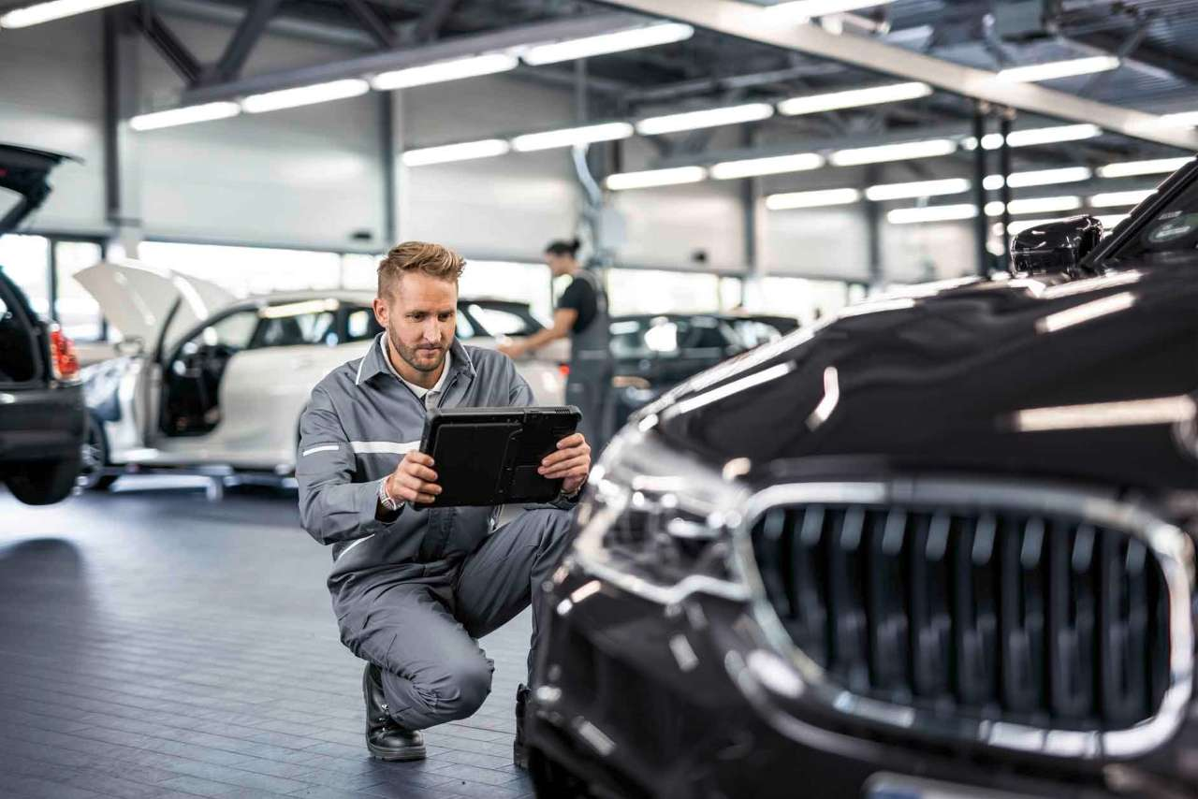
Technology
Digital companion on smartphone
Energy independence
Autonomous Driving
Artificial intelligence for IT support and customer service engagement
Digital sales
Data analytics to better understand customer's needs
Advanced R&D systems
AI for production unites

Slide 117
Sales
Online marketplace
Multiple payment options
Individually configured custom vehicle
Custom add on (example: charging solution )
Personalized suggestions based on voluntary customer shared data

Slide 118
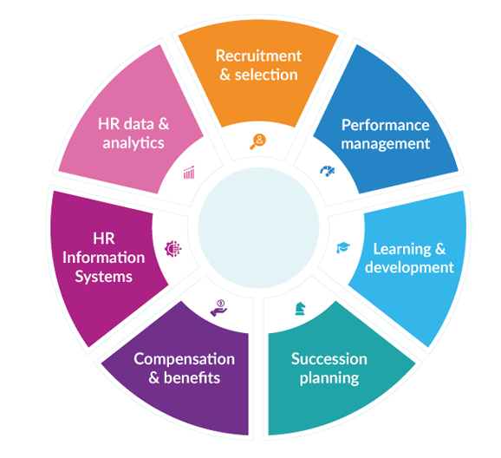
Human Resources
Hiring:
Hiring people with skills in Automobile Engineering, Artificial Intelligence, EV specialist and Analytics
Have the right balance of necessary external talent hiring, internal employees and consultants if required in new markets.
Retaining IT Talent:
Good work culture , competitive salary and employee benefits
Encouraging knowledge sharing between employees, aligning them with company’s vision
Emphasis on the importance of innovation and opportunity to try new things without obstacles

Slide 119
Human Resources
Training:
Training of employees for latest technology advancements and expand their capabilities in personal and professional characteristics.
Incentives for employees to complete the trainings
Senior Management encouragement to train existing employees to increase retention and decrease the need for external hiring
Outsourcing:
Strategy: Select vendors who have expertise in team collaboration products and digital markets.
Risk: Have an internal team and manager to coordinate with the outsource company. They will report to and inform a director about the process and actions.
Jobs: Outsource work that will take time to develop in house expertise, to keep up with the market.
Metrics: The outsource company can report their progress to the manager and discuss metrics such as bugs or issues fixed and average response time.

Slide 120
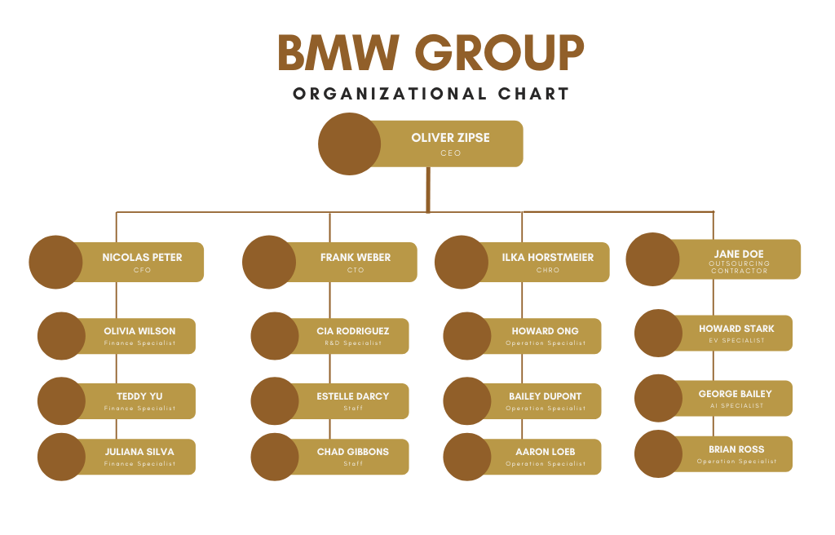
Human Resources (Staffing – high level)

Slide 121
Success Metrics
Onboarding Time
Cost per Hire
Early Turnover
Performance and Potential
Billable hours
Time since promotion
Revenue per employee
Engagement Rating
Turnover
Attrition Rate
Absenteeism
Employee Happiness
Training Effectiveness Index
Training expense

Slide 122
Implementation Strategy

Slide 123
Phase I: Departmental Wise AI Implementation
Research & Development
AI- Based management in vehicles
Supply Chain Management and Logistics
Integrating AI with facility and robot control systems
Production
Dust Particle Analysis
After Sales & Customer Service
Buildings Management
Administration & Support Functions
Customer & Vehicle Functions
Acoustic Analytics
Requirements Management
Pseudo Defects
Quality checks and automated assembly
Dealer service desk
AI and customer interaction
Energy Consumption data being analysed for tapping undiscovered patterns of usage
Customed Machine Translation (CMT)
Driver Assistant
Intelligent Personal Assistant

Slide 124
Phase II: Data Handling Strategy
Data Aggregation
Data Structure and Modelling
Generating Database to be used by AI
Prepare Data for Machine Learning
Data Aggregation
Integration of all the data sources
Integrating ERP with current System
Data Structure and Modelling
Create data storage structures and models for different data types departmental wise
Create a standardized format for storing data and to frame it as per AI requirements
Prepare Data for Machine Learning
Implement continuous data feed for content filtering
Data handling for building recommendation system and auto tagging.
Generating Database to be used by AI
Migration of Big Data to a particular database by using NoSQL
Security concerns being resolved, and new policies being generated with respect to AI

Slide 125
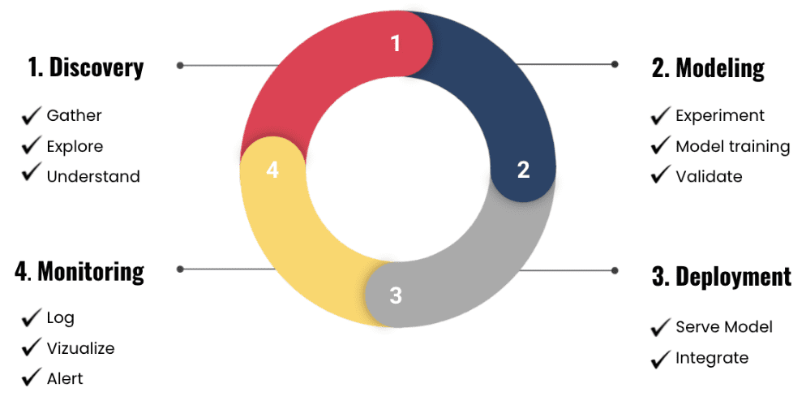
Phase III: AI Implementation
Discovery:
Churn Rate
Monotonous Tasks
Predictive Maintenance
Inventory/Demand Forecasting
MLOps:
Development of reference architecture
Data model
Model Registry
DevOps Tools
Monitor and Control
Identifying Partners and Vendors and clarifying the expectations to them
RoadMap Development:
Using Agile Framework
(Agility + Iteration)

Slide 126
Milestone Chart
R&D Implementation
Development of standardized framework which could be used by all the departments
Supply Chain and Logistics, Customer Service & Production
Alignment of strategic goals and knowledge generation for customers (automating production line and integrating 70% of non-monotonous tasks with AI)
Facilities and Support Services
Integrating AI with facilities and automating the support processes (electricity control, power consumption, etc.)
Customer and Vehicle Function
Installation of BMW assistant AI in all the vehicles and enabling 55% of features availability
Data Aggregation and ML
Collecting the required amount of data and sorting it as per the requirements of the OS
Generation of DB
Creation of DB which is successfully able to handle BigData as well as the department’s data
AI Implementation
Integrating AI with 77% of the daily operations

Slide 127
Rollout Plan
AI Personal Assistant
Encourage users to use the bot
Providing them with the list of customization options available
Autonomous Driver
Providing tutorial and personal attention to all the customers
Highlighting the benefits and gaining their trust
Project AI
Informing customers about the features and capabilities
Project AI would itself be implemented in a step-by-step manner
Complete integration occurs at this stage
Boosting the production of electric vehicles at the same time
Collecting as much amount of data as possible

Slide 128
Measurement and Metrics

Slide 129
Traditional Measures
Working Capital Turnover Ratio/Current Ratio: Indicates a company’s ability to pay its current liabilities with its current assets.
WCTR = CA/CL
Quick Ratio/Acid Test: Indicates the ability of a company to pay its short-term obligations.
QR = (CA-Inventories)/CL
Earnings Per Share (EPS): Net income earned on each share of a company.
EPS = Net Income-Preferred Dividends/Weighted Average Shares Outstanding During the Year
Price-Earning Ratio (P/E Ratio): Indicates investors’ assessment of future earnings
P/E = Stock Price/EPS
Debt-Equity Ratio (D/E Ratio): Indicates how much a company has borrowed money
D/E = (Long Term Debt + Short Term Debt)/ Shareholder’s Equity
Return on Equity (ROE): Indicates how much profitable is an investment in a company
ROE = (NPAT-Preferred Dividends)/Shareholder’s Equity

Slide 130
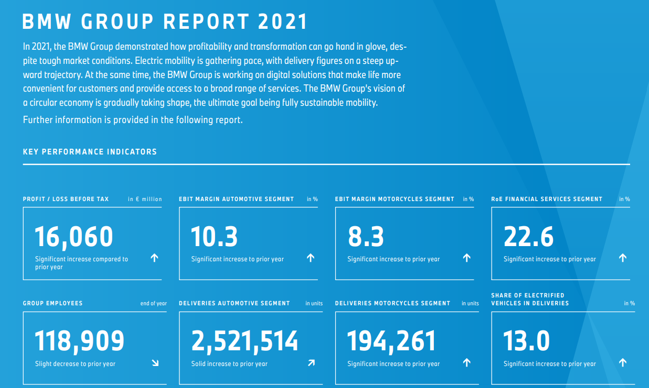
BMW Financials (Group Wise Profit Indicator)

Slide 131
Traditional Measures
Ratio | Value | High/Medium/Low
WCTR | 1.33 | Medium
QR | 0.75 | Low
EPS | -5.23 | Low
P/E | 3.76 | Low
D/E | 0.47 | Medium
ROE | -27.50 | Low

Slide 132
New Metrics
Customer Interaction
Number of screen taps made by the customer
Customer Satisfaction
Customer Complaints
Frequency of Complaints
Customer Service Improvising Tools
Number of times customer used Bot or WeChat to perform functions for them
4 Question survey
Number of times customer had to repeat the instructions to the Bot
Number of times the product had to be serviced
Analysing VOC patterns
Showroom Visit
Churn Rate
BMW Network Connectivity ensuring product health using AI
Monitoring 24x7 safety services and frequency of those requests regionally
Speed monitoring and frequency of travelling to ensure the best possible driving mode
Reselling Duration
Number of features accessed and which were not

Slide 133
Balance Scorecard
Financial Perspective
(Increasing the key financial metrics)
1. Identify market opportunities
2. Stabilize production cost
3. Reduce number of returns
Customer Perspective
(Increase customer satisfaction)
1. Customer Service
2. Innovation Management
3. Customer loyalty program
Internal/Business Perspective
(Exploit process change effectively)
1. Improve integration between AI and internal processes
2. Benchmarking
3. Using AI for getting best product and features combination
Learning & Growth Perspective
(Building internal relationships and improving quality of innovations)
1. Customer and Employees training program
2. Learning about AI related possibilities
3. Using core quality improvement tools like lean and agile management

Slide 134
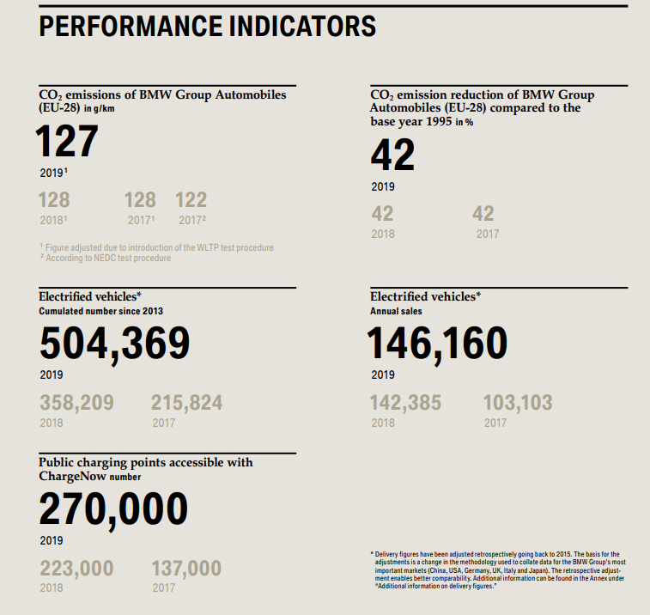

Slide 135
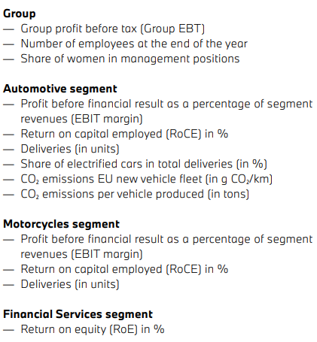
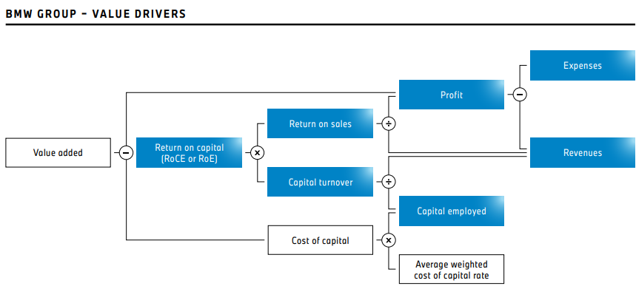
Value Measurement

Slide 136
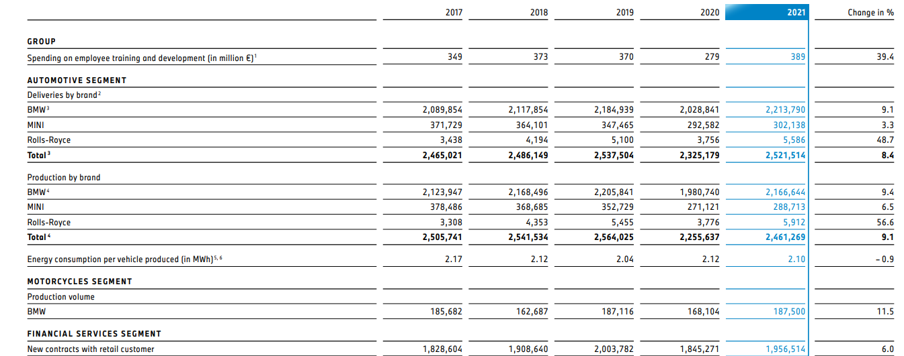
Value Measurement

Slide 137
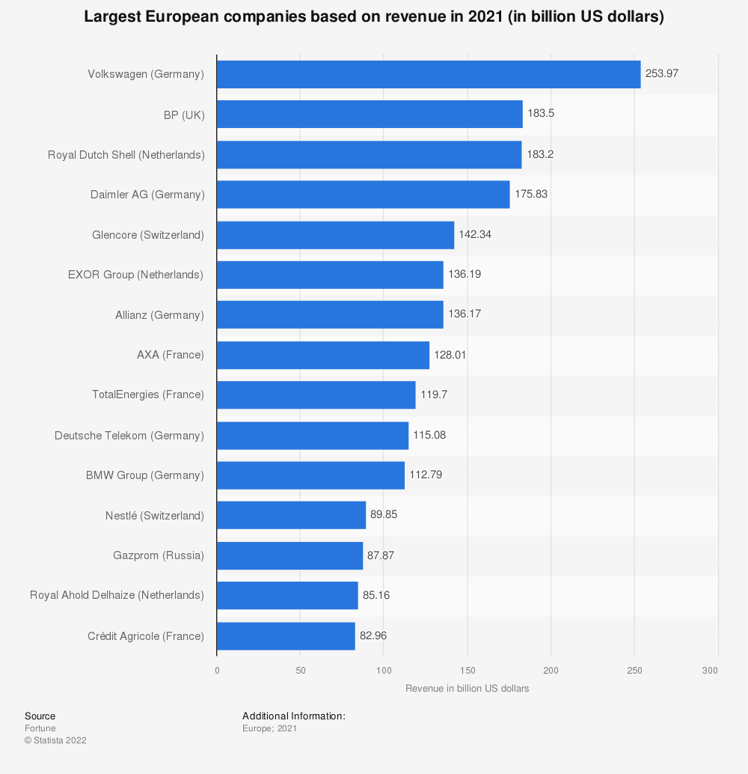
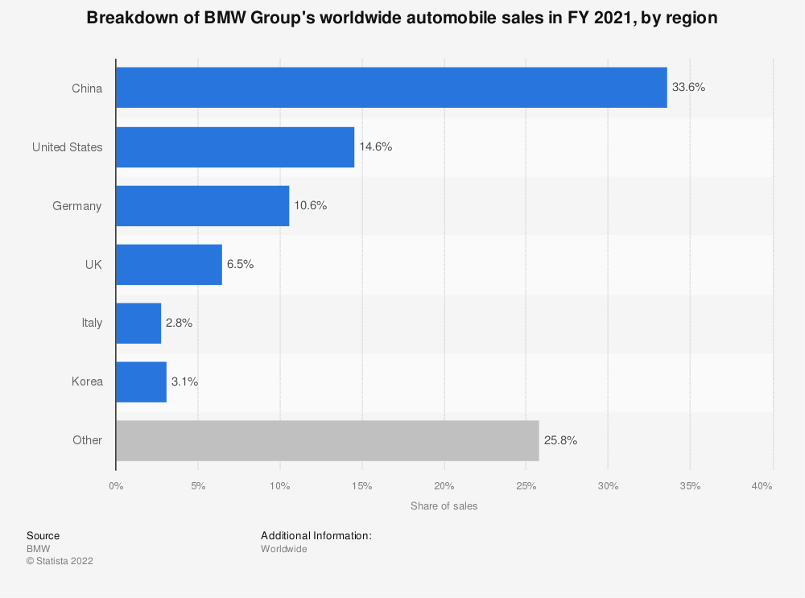
Further Analysis

Slide 138
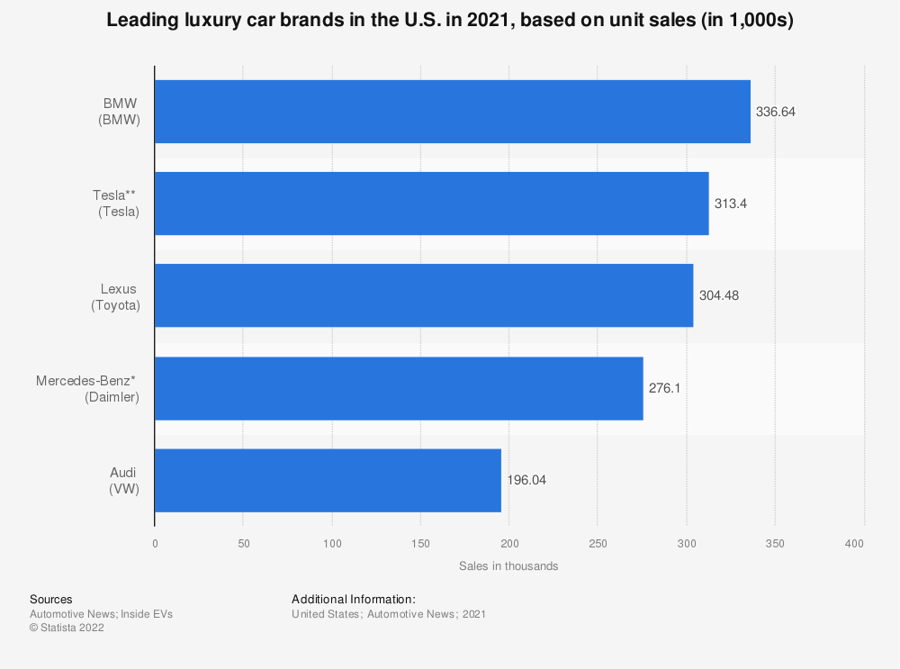
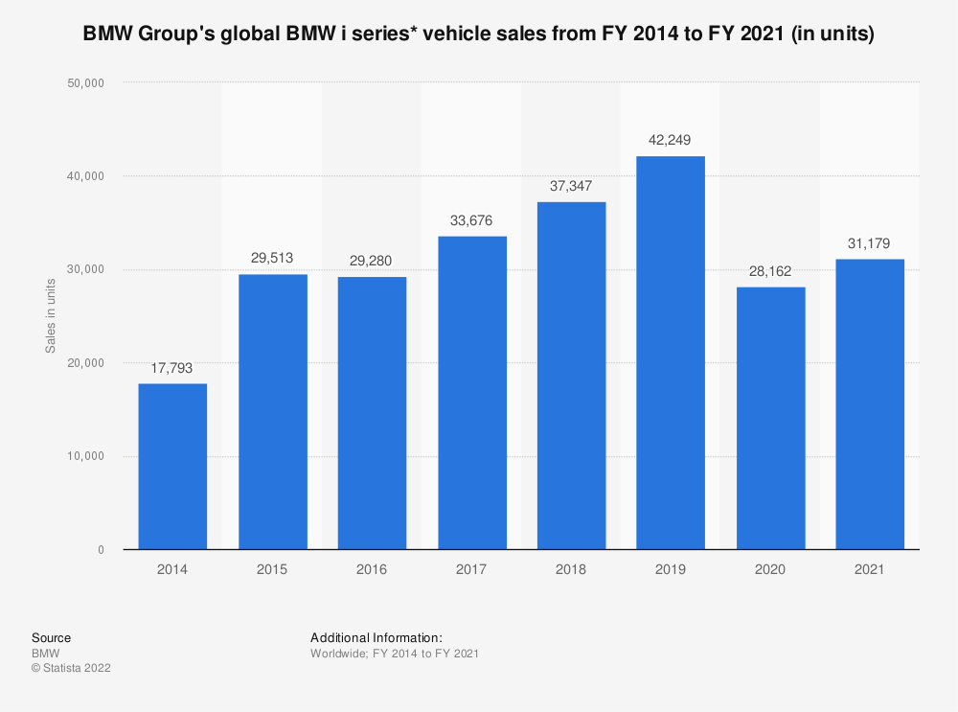
Further Analysis

Slide 139
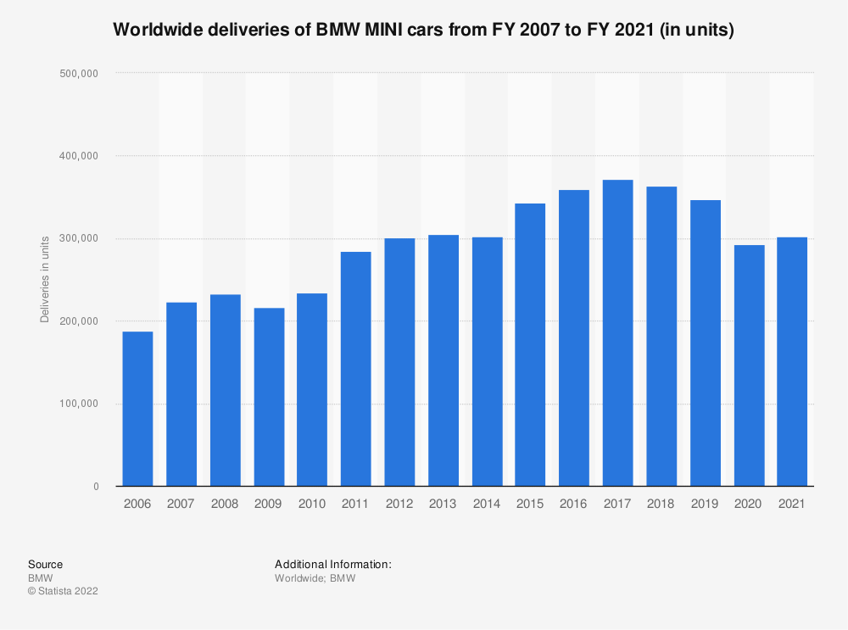
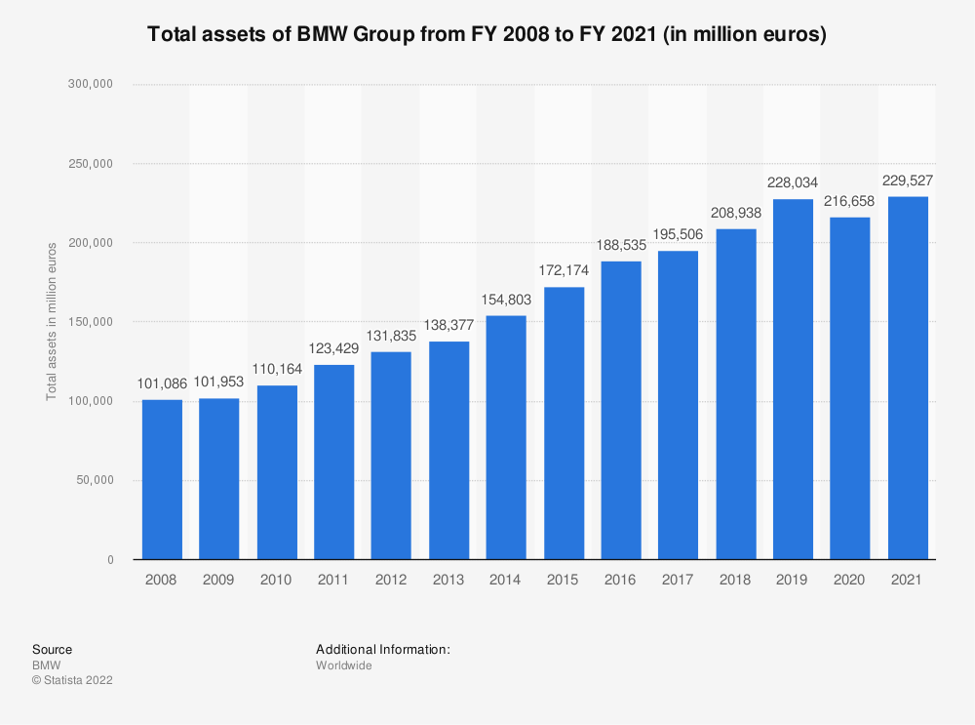
Further Analysis

Slide 140
Link between IT metrices and Business
The key to linking IT to business performance creates an environment where everyone understands
what measures are important to the business and are accountable for them.
Enterprise Measures
Ties the work of IT directly to the performance of the organization.
Example: Customer Satisfaction, Corporate Financial Performance.
Functional Measures
Assess the internal work of the IT organization as a whole.
Example: IT employee satisfaction, internal customer satisfaction, operational performance, development productivity.
Project Measures
Assess the performance of a project team in delivering specific value to the organization
Example: Business case benefits, Delivery on time

Slide 141
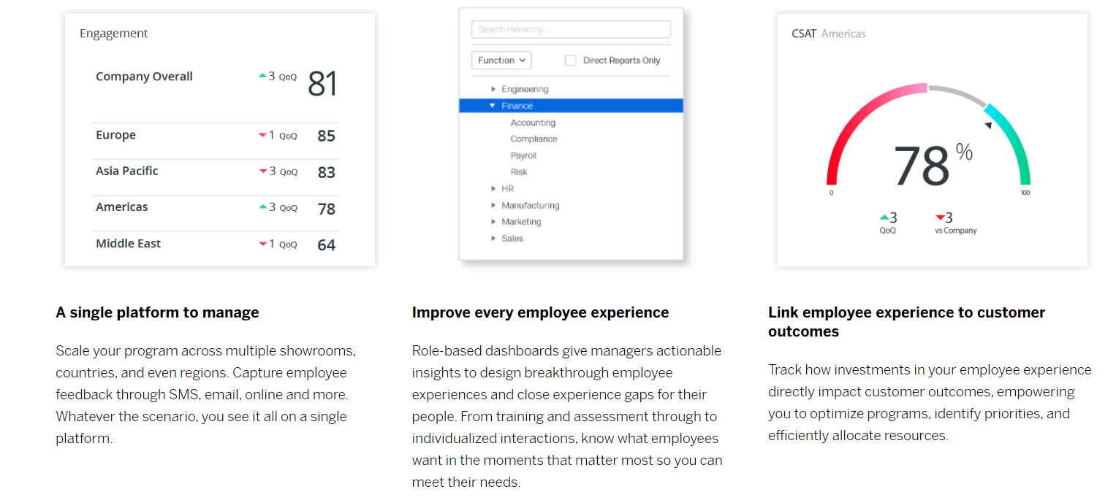
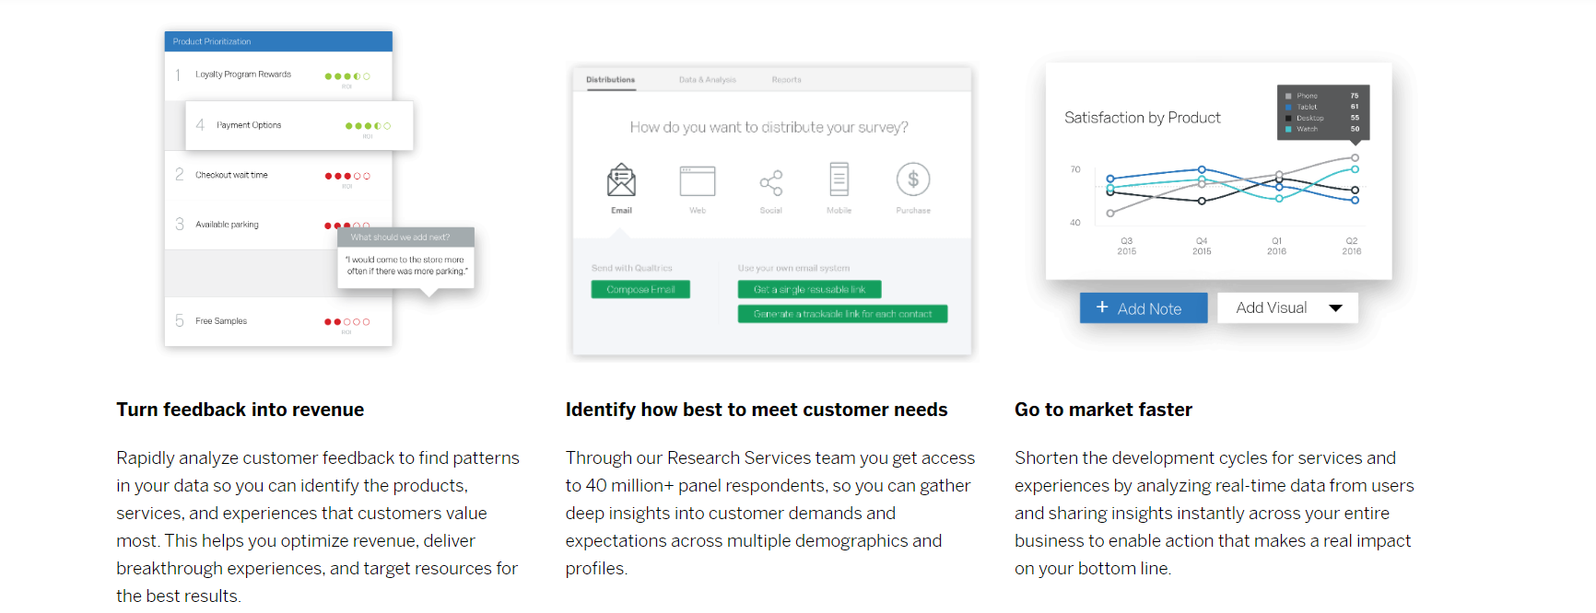
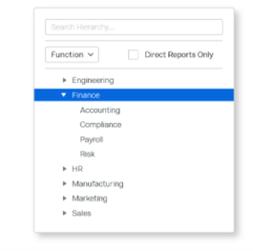
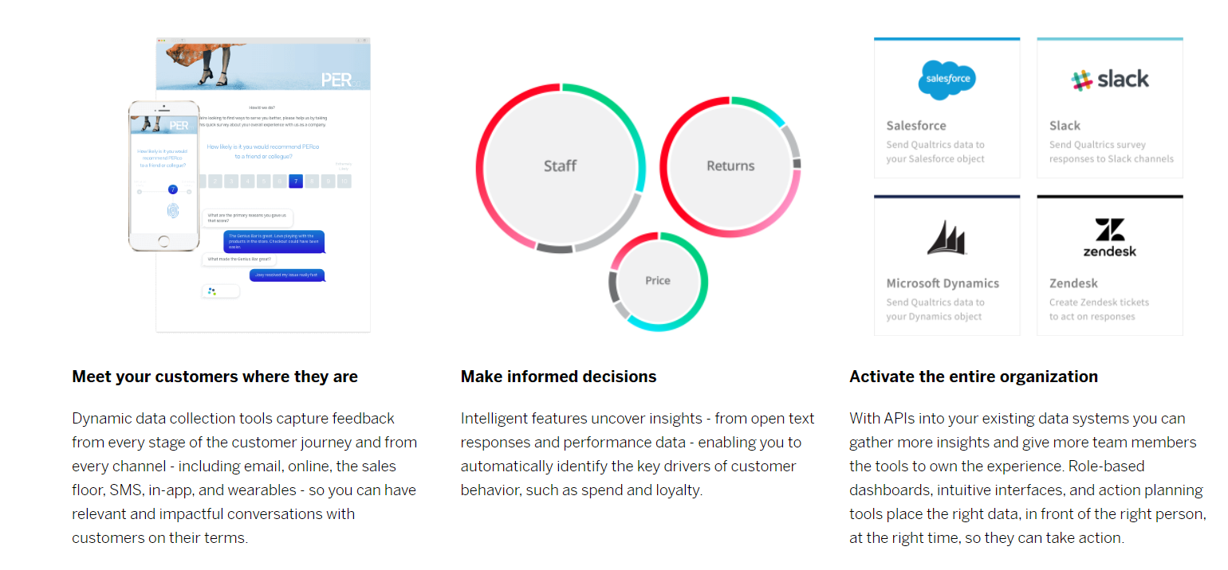
Dashboard

Slide 142
Issues

Slide 143
Government regulations and policies (Political and Legal environment)
Global Regulations are expected to be in place for autonomous driving by 2025
California's regulations would require new car sales for model year 2026 to be zero-emission vehicle and new gas car sales to end by 2035.
As future vehicles will be data-driven smart vehicles, regulators are expected to enforce new laws that will protect consumers’ personal information, data, and privacy
New global regulations are expected to protect the rights of labor and hence will increase the cost of vehicle. Automakers need to invest more on robotics and plant automation
New tax laws changing the rebate policy for Electric Vehicles may impact the sale and decrease the consumer affordability.
Paris Climate Agreement and policymakers in Europe are also working on addressing the climate protection and sustainability

Slide 144
Technology environment
Autonomous driving cars have issues in precisely detecting the highway markings and signs to control speed on curves hence increasing the chances of road accidents
Future autonomous driving cars are expected to communicate with one another using sensors and Artificial intelligence. This may cause data privacy, ethics and other concerns.
Infrastructure for charging electric Vehicles needs to be enhanced to provide more frequent charging highway platforms
Dependency on third party technologies for example apple car play must be reduced
Competitors who form alliance with right partners to develop more advanced batteries with longer charging life will win the race.

Slide 145
Macroeconomic environment
Fewer teenagers (aged 16–19 ), are getting licenses since 1983
Reduction in auto industry share over GDP
(5% to 3% since 1961)
Vehicle-driver ratio has stalled to 1.15 per licensed driver since 2021
Reduction in world Gross Domestic Product (GDP) growth rate among developed nations
Rising interest rates will impact consumer affordability reducing industry revenues
Macroeconomics will impact BMWG revenues
A V-Shaped COVID recovery is in progress with Consumer demand for autos has risen in 2021​
The high global inflation will reduce consumer affordability hence reducing auto industry revenues
Global supply chain shortage of semiconductor has caused a reduction in vehicle production creating long wait list for the consumers.

Slide 146
Social environment
Smart revolution has prompted automakers to rethink on how to define convenience and luxury e.g., unique technology allowing the car exterior to change color, fully autonomous cars
Green revolution is also defining the consumer preference towards Electric Vehicles vs Gas Guzzlers
Government policies related to vehicle usage and changing social values and norms may also change Customer behavior.
Social standards defining the respect for human rights in the supply chain also impacts the procurement of raw materials for automobile manufacturers
Rising fuel and crude oil costs may also be factors in how customer buying preference will change in favor of EVs versus Gas vehicles.
Increasing global vehicle population also poses traffic and infrastructure challenges that may impact customers to prefer public transportation for commute vs using private cars.
BMW's business and IT strategy will have to keep these social behavior and environmental conditions into account when investing in its R&D for transforming the company to meet future challenges and to gain the competitive advantage.

Slide 147



Demographic environment
In the US, the Hispanic and Asian population is expected to increase in next 30 years. This change in demographics may also facilitate more market share for European and Asian automakers
The Census Bureau projects a U.S. population of 417 million in 2060, a 38% increase from 2007.
For automakers, the demographic change in world major economies will both be a challenge and an opportunity.
US and European population is growing older whereas Asian and Hispanic population in growing younger. This may also be a factor in why and how automakers should increase their market share in economies like China, India, Brazil and Mexico.
Notes:
Graphs extracted from US Census Bureau, PBS.org and bbc.com

Slide 148
Complementors
Auto financing firms are the complimenting business for auto industry that facilitates car sales e.g., Credit Unions, Major Banks and automakers own financing companies.
Some car makers can also complement each other when promoting new Technolgies e.g., BMW, Mercedes Benz and Audi AG working on next generation technologies like Fully Autonomous Driving.
Poor quality or major recalls for one automaker vehicle can complement increase in auto sales for its competitors.
Competitors can work together with their alliances and partners to create an ecosystem through exclusive contracts that may complement each other products e.g., battery makers, performance tire makers, apple car play, JBL, BOSE and Harmon Kadon audio systems and other smart technologies that will define the future next generation cars.

Slide 149
Others
The old consumers e.g., drivers of BMW 7 series and Rolls Royce luxury vehicles are mostly 55 plus and may find it hard to use new Smart automobile Technologies even though future cars may offer those convenience packages, the real challenge would be to make the technology as user-friendly and intuitive so that senior customers can value them and be willing to pay a premium price for it.

Slide 150
Conclusion

Slide 151
Conclusion
BMW is the one of those companies which is having the capability to bring a radical change using IT in the market due to their focused approach. The way BMW would be able to leverage technology would provide a direction to many other industries.
One of the biggest advantage that BMW has is having a focused approach towards their customers. This enables them to perform at their best and to perfectly align their business with IT.
Environment, Competition and Threats
Business Strategy:
To create a smart world enabled by AI for achieving peak performance and serving customers with premium quality service
IT Strategy:
Integrating ML, NPL, deep learning and AI with the current processes and updating current technology to supportive advanced technology
True Partnership:
Creating a collaborative environment with between IT and business for exploiting one another’s benefits
Improved Business Performance
Alignment
Drives
Competitive Advantage

Slide 152
References
https://www.bmwgroup.com/en/company/strategy.html
https://www.v7labs.com/blog/ai-in-manufacturing
https://www.press.bmwgroup.com/global/article/detail/T0308184EN/bmw-group-plans-for-various-scenarios-and-can-react-swiftly-to-new-developments?language=en
https://www.phdata.io/blog/how-to-implement-ai-strategy/#how-to-build-a-successful-ai-strategy
https://www.investopedia.com/financial-edge/0910/6-basic-financial-ratios-and-what-they-tell-you.aspx
https://digitalagencynetwork.com/6-key-points-about-the-digital-marketing-strategy-of-bmw/
https://www2.deloitte.com/us/en/insights/economy/spotlight/automobile-impact-us-economy.html
https://www.qualtrics.com/customers/bmw/
https://epaper.chinadaily.com.cn/a/202011/04/WS5fa1f120a31099a2343517f3.html
https://www.moneycontrol.com/financials/bmwindustrieslimited/ratiosVI/BMW54266#BMW54266
https://www.statista.com/
https://www.bmw.com/en/events/iaa2021/future-vision-questions-and-answers.html
https://www.press.bmwgroup.com/global/article/detail/T0324289EN/new-sales-and-marketing-strategy:-bmw-group-optimistic-about-2021-after-posting-record-q4-sales?language=en
https://www.bmwgroup.com/en/innovation/technologies-and-mobility/artificial-intelligence.html#ace-153565806
https://www.bmwgroup.com/en/innovation/technologies-and-mobility/connectivity.html
https://mission-statement.com/bmw/
https://www.bmwgroup.com/en/company/the-next-100-years/brandvisions.html
https://digitalagencynetwork.com/6-key-points-about-the-digital-marketing-strategy-of-bmw/
https://blogs.sap.com/2018/12/11/how-to-derive-your-viable-cloud-strategy-a-case-for-sap-hana-enterprise-a-multi-cloud-offering.-part-1/
https://medium.com/@viebig/alignment-and-buy-in-are-pms-worst-enemy-03-ways-to-defeat-it-f73a0d495d4f
https://www.commpro.biz/how-employees-at-bmw-drive-awareness-engagement-free-webinar/
https://pmworldlibrary.net/wp-content/uploads/2016/03/pmwj44-Mar2016-Trokic-Sahatqija-Koehler-Machovsky-The-Case-of-BMWi.pdf

